Slide 1
Session ID: 115
April 10, 2010
Enabling Functional Users with Argos
Bruce Knox
Project/Program Director
University of Arkansas, Division of Agriculture, Cooperative Extension Service
bknox@uaex.edu

Slide 2
Session Rules of Etiquette
Please turn off your cell phone.
If you must leave the session early, please do so discreetly and quietly.
Please avoid side conversation during the session.
Thank you for you cooperation!

Slide 3
What is this session about?

Slide 4
What is this session about?
Using Argos to Enable Users

Slide 5
What is this session about?
Using Argos to Enable Users
Freeing the Technical Staff

Slide 6
What is this session about?
Using Argos to Enable Users
Freeing the Technical Staff
Oriented to those that code

Slide 7
What is this session about?
Using Argos to Enable Users
Freeing the Technical Staff
Oriented to those that code
And to those dependent upon them

Slide 8
Before you get too far into that being impossible …

Slide 9
My favorite Argos QuickView
Notes:
QuickViews are for entry or Parameters or can be used as Forms. I tend to use a combination of both.

Slide 10
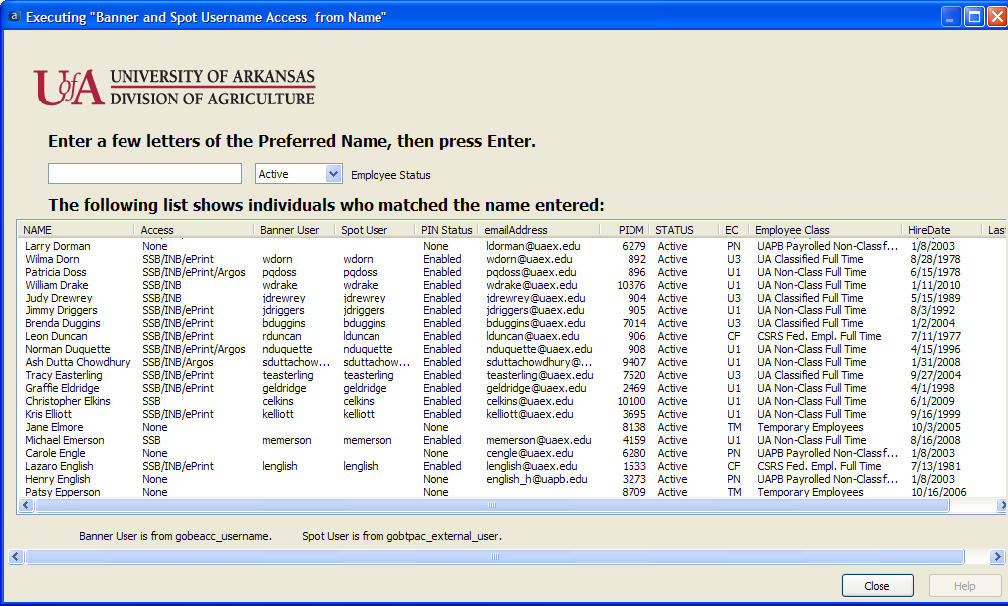
My favorite Argos QuickView
Notes:
Built to answer the Call Center/Help Desk’s questions about user access.

Slide 11
What will you take away from this session?

Slide 12
What will you take away from this session?
A Technical user’s approach to quick results with minimal investment.

Slide 13
What will you take away from this session?
A Technical user’s approach to quick results with minimal investment.
A way to use your preferred tools and your Functional users’ preferred interface.

Slide 14
What will you take away from this session?
A Technical user’s approach to quick results with minimal investment.
A way to use your preferred tools and your Functional users’ preferred interface.
Functional users will get a hint of what we can do for them.

Slide 15
My favorite Argos QuickView
Notes:
Usually one wants only a known Active Employee. (Hint: Every employee has a space in their name.)

Slide 16
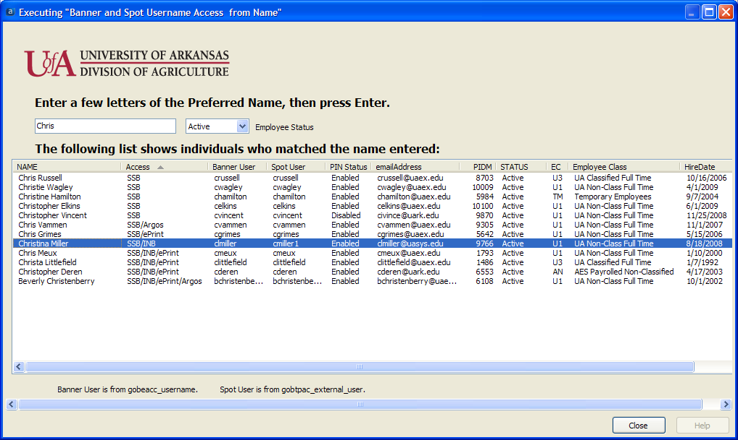
My favorite Argos QuickView
Notes:
Answers questions quickly for users that cannot resolve the question any other way than to ask their DBA.

Slide 17
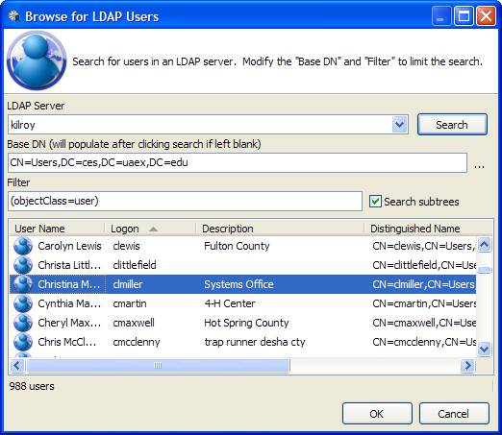
My favorite Argos QuickView
Notes:
I do not have a Query to use in Argos Reports for LDAP, yet.

Slide 18
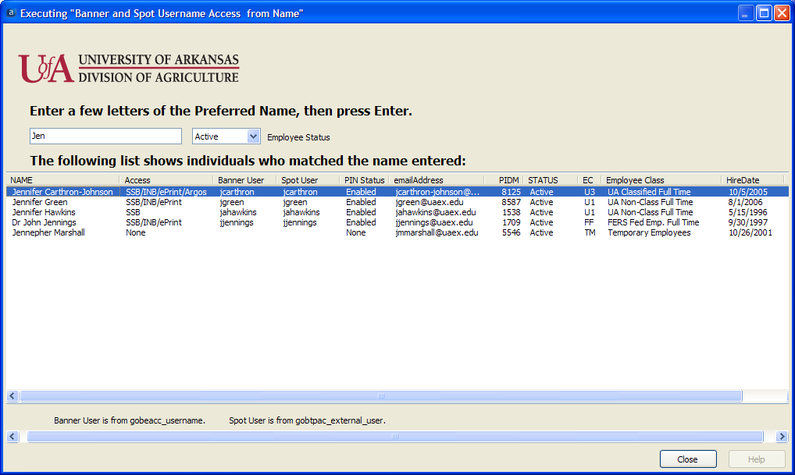
This is for our Call Center/Help Desk
Notes:
Here is one that still needs a solution.

Slide 19
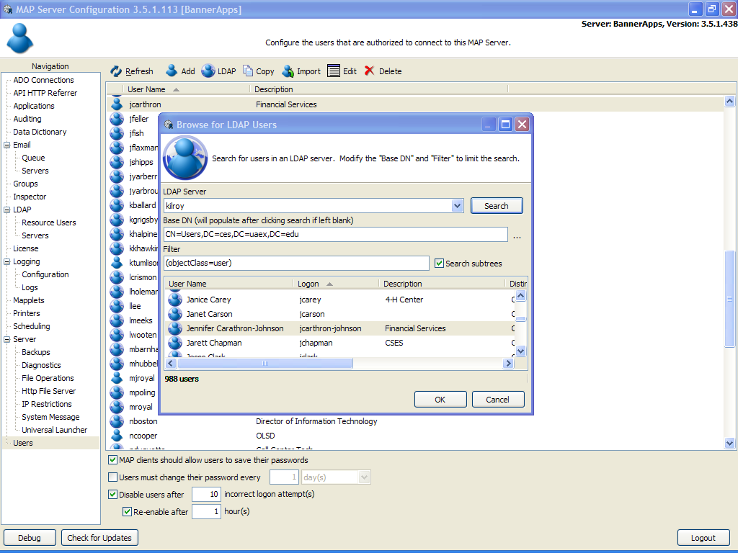
Why?
Notes:
Getting LDAP information into Oracle is hindered by LDAP being a non-SQL data source.

Slide 20
My favorite Argos QuickView
Notes:
Enter a space for the preferred name and you get all employees.

Slide 21
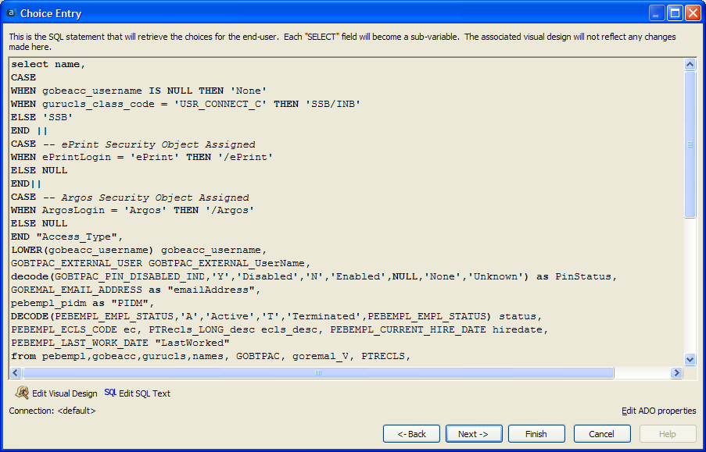
My favorite Argos QuickView
Notes:
This is the code behind the Query.

Slide 22
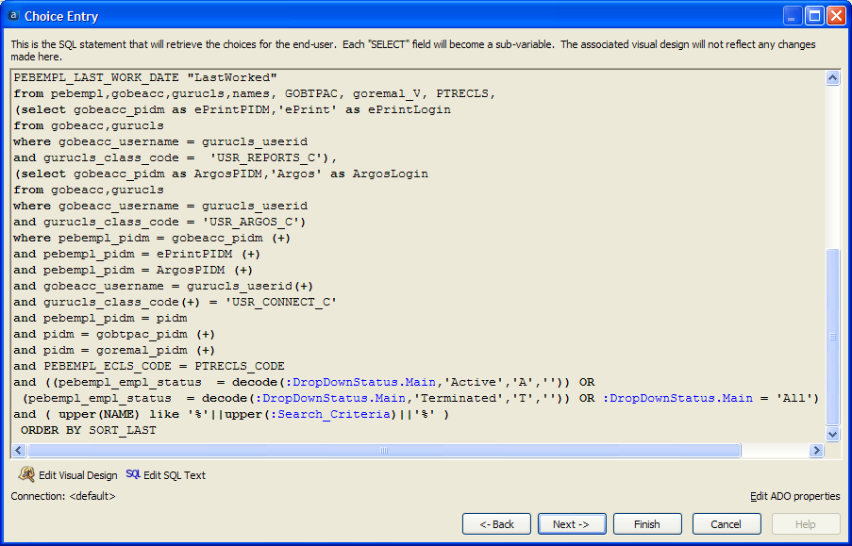
My favorite Argos QuickView
Notes:
The rest of the code.

Slide 23
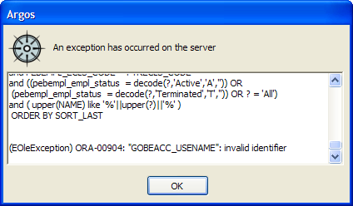
My favorite Argos QuickView
Notes:
Misspell a field name and Argos will ID the problem.

Slide 24
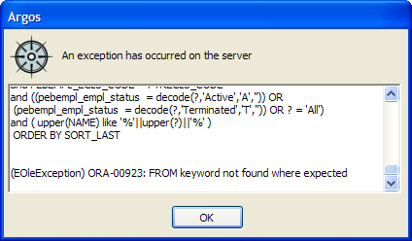
My favorite Argos QuickView
Notes:
Leave out a comma and you are on your own. This isn’t Argos’ fault; it is the nature of the Oracle OLE DB connection.

Slide 25
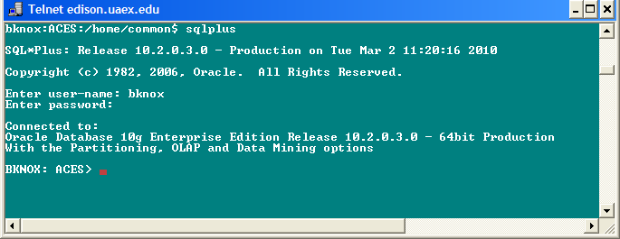
My favorite Argos QuickView
Notes:
Here is the solution to debugging your code. Start as near the native Oracle system as possible. SQL*Plus command line is always there.

Slide 26
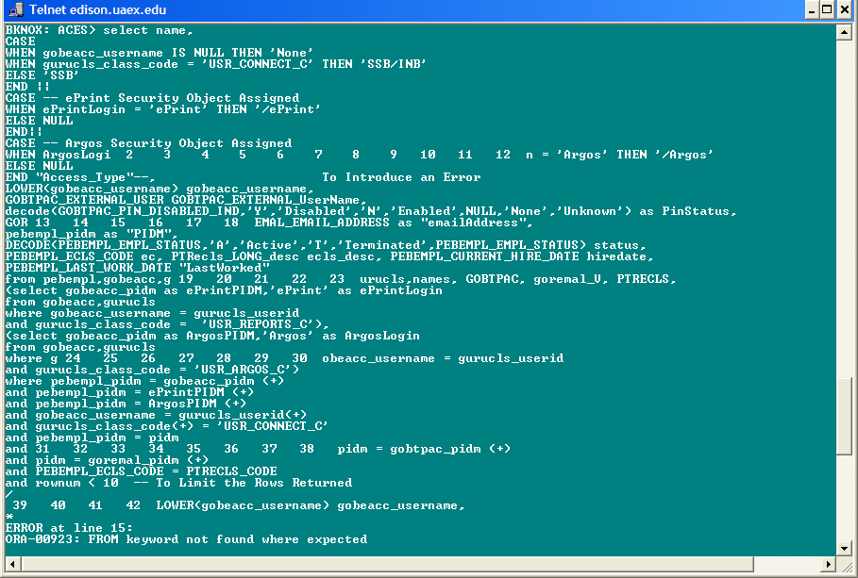
My favorite Argos QuickView
Notes:
Which in SQL*Plus shows you the line number containing the error.

Slide 27
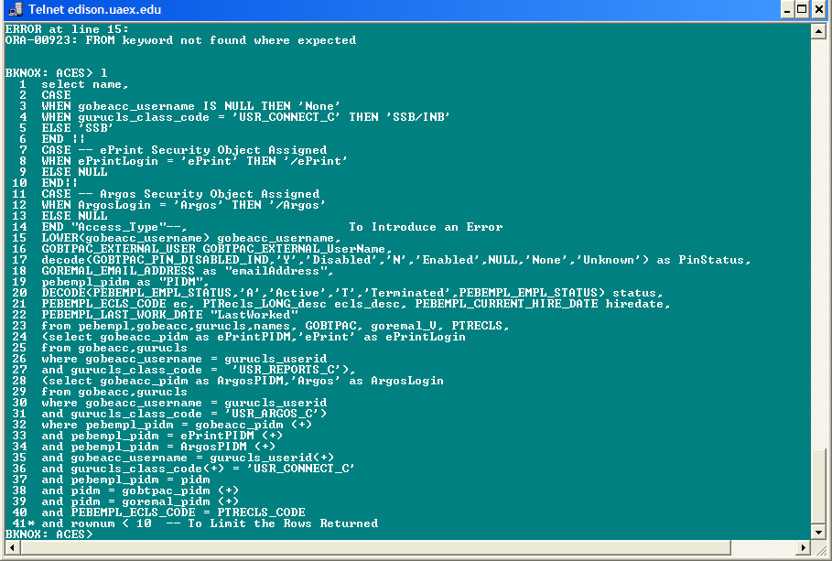
My favorite Argos QuickView
Notes:
OK, very near the line number of the error;)

Slide 28
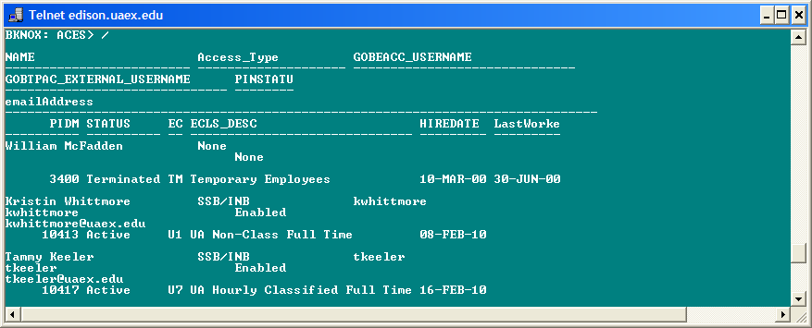
My favorite Argos QuickView
Notes:
Fix the error and confirm the results.

Slide 29
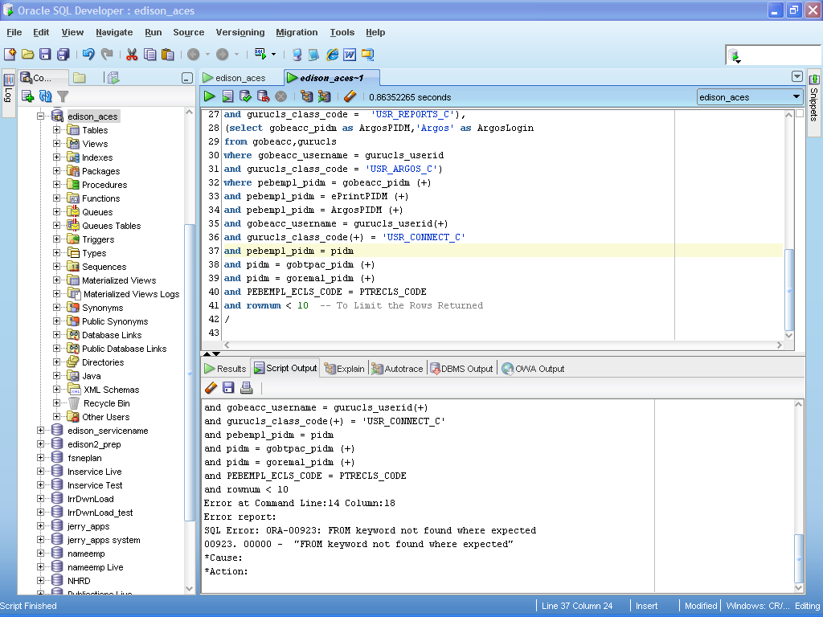
My favorite Argos QuickView
Notes:
Cannot get to the SQL*Plus command-line? Try the free SQL*Developer (it even found the right statement number) or buy Toad.

Slide 30
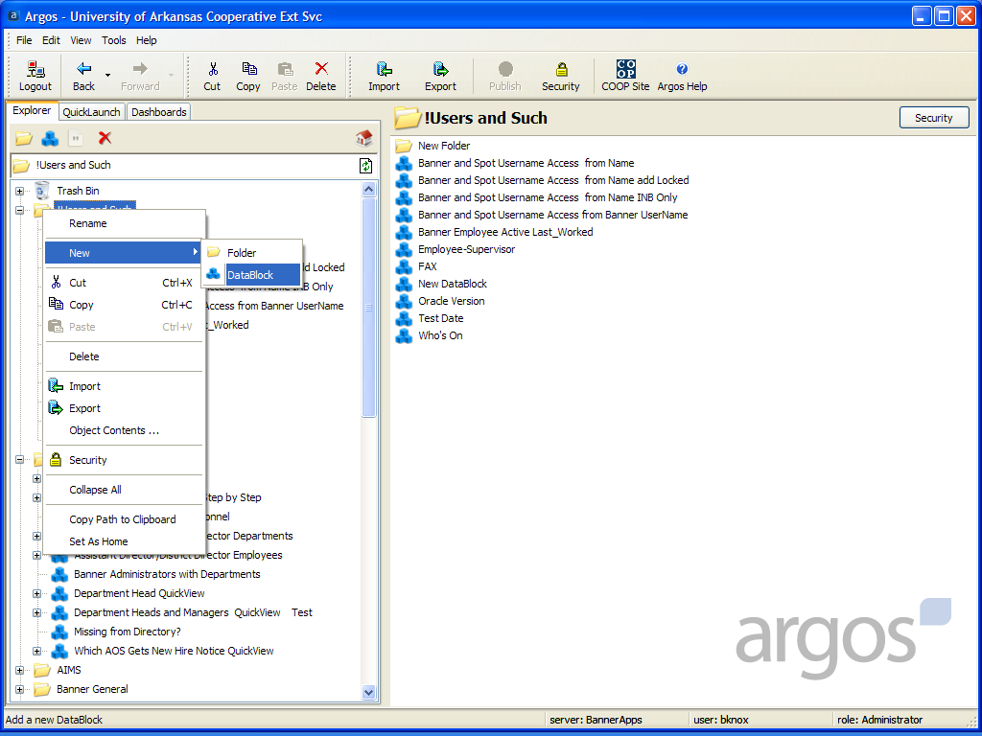
My favorite Argos QuickView
Notes:
Now for a place for the code in Argos. A DataBlock is a Query+.

Slide 31
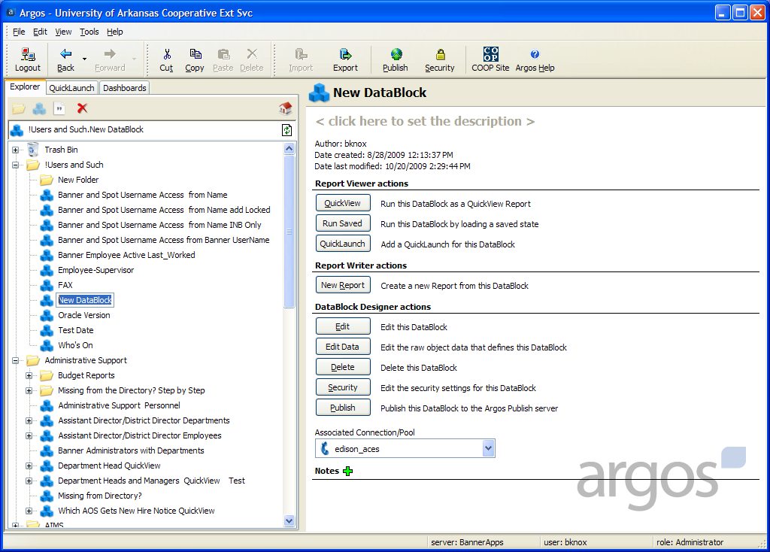
My favorite Argos QuickView
Notes:
Rename it.

Slide 32
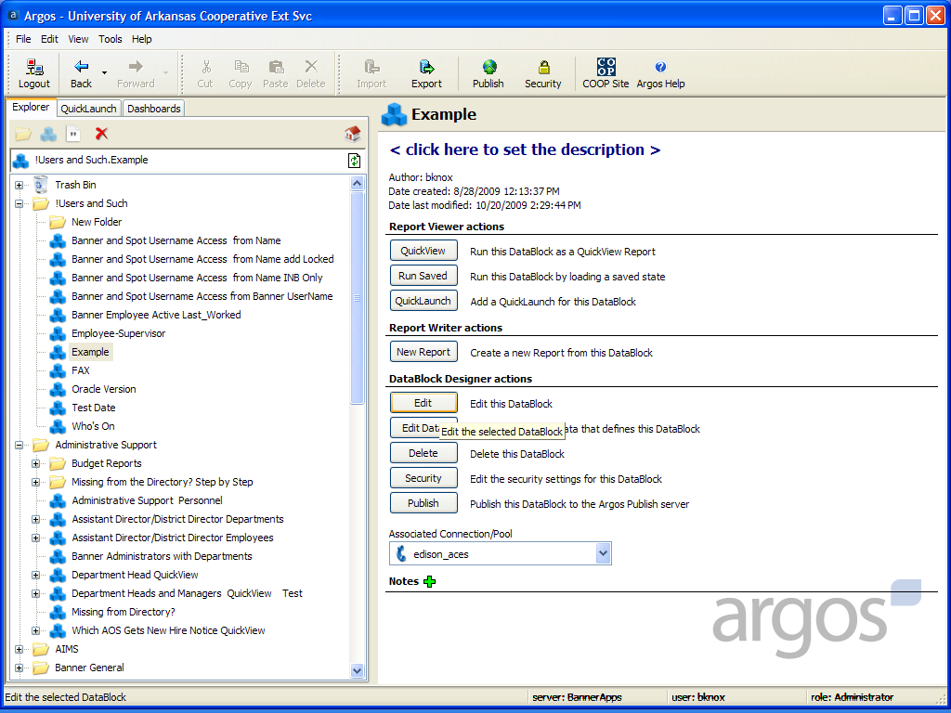
My favorite Argos QuickView
Notes:
Give it a default Connection and Edit the DataBlock shell.

Slide 33
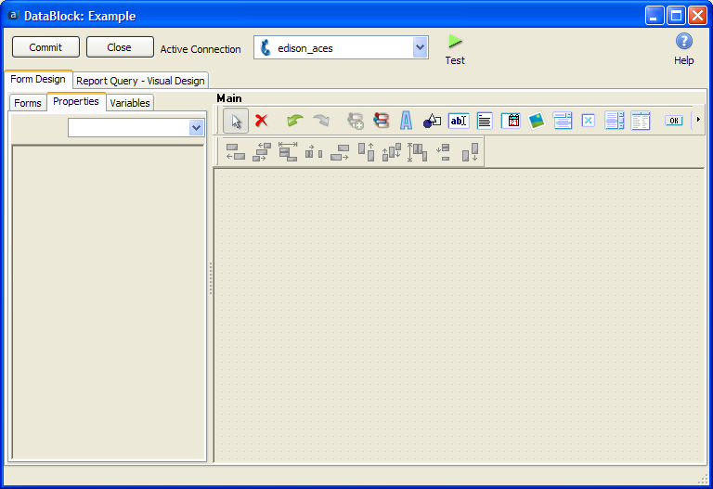
My favorite Argos QuickView
Notes:
Icons! The bane of the command-line programmer, but the bliss of the GUI programmer.

Slide 34
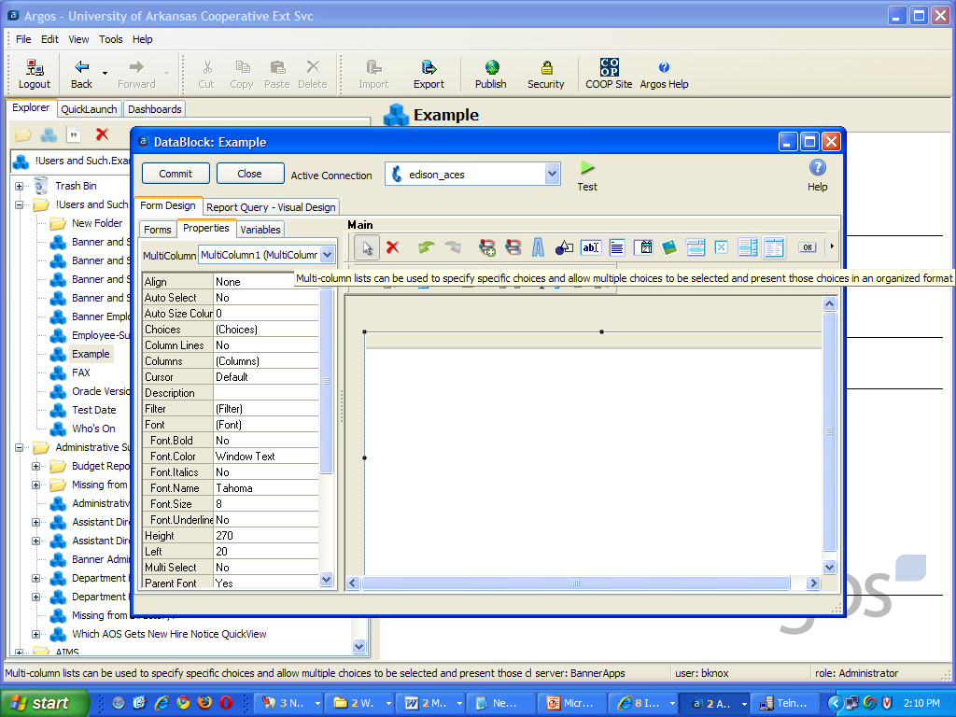
My favorite Argos QuickView
Notes:
Next slide.

Slide 35
My favorite Argos QuickView
Notes:
Click on the Multi-column icon. Click on a location in the panel. Double-Click on the new object.

Slide 36
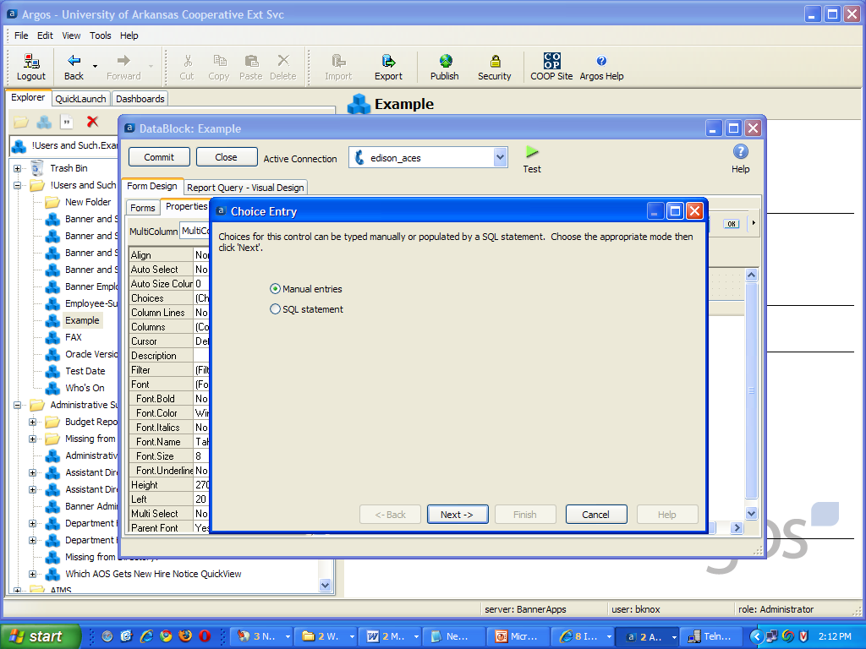
My favorite Argos QuickView
Notes:
Skip the Manual entries.

Slide 37

My favorite Argos QuickView
Notes:
SQL statement and Next.

Slide 38
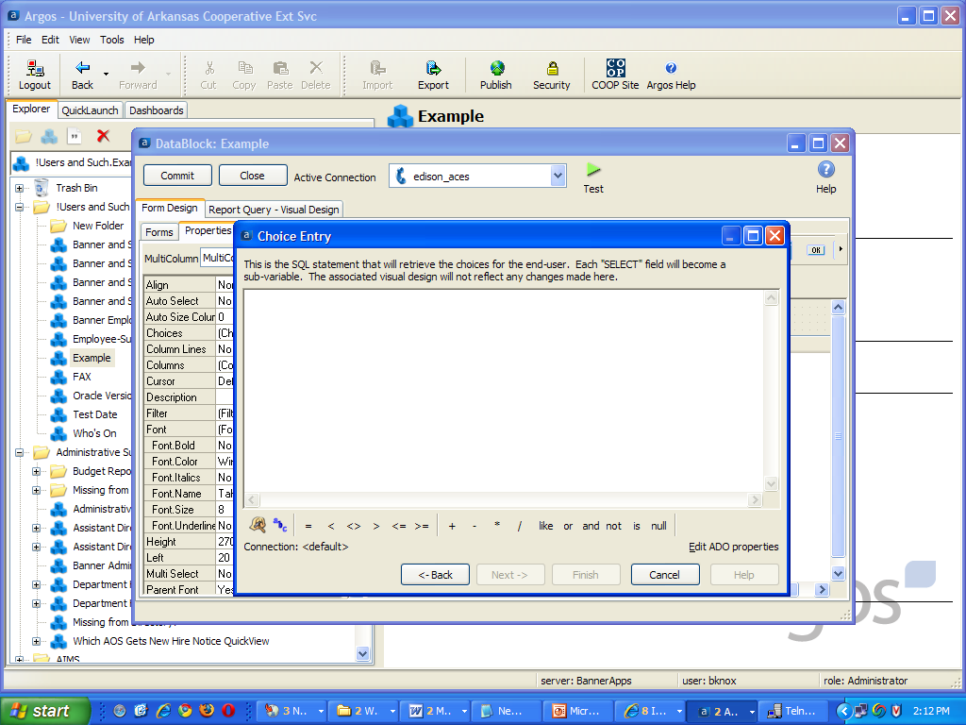
My favorite Argos QuickView
Notes:
Now we can paste in the SQL*Plus developed code (leave the SQL*Plus extensions out).

Slide 39
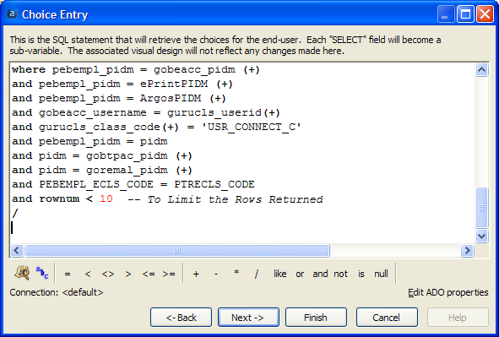
My favorite Argos QuickView
Notes:
Paste in your SQL*Plus developed code.

Slide 40
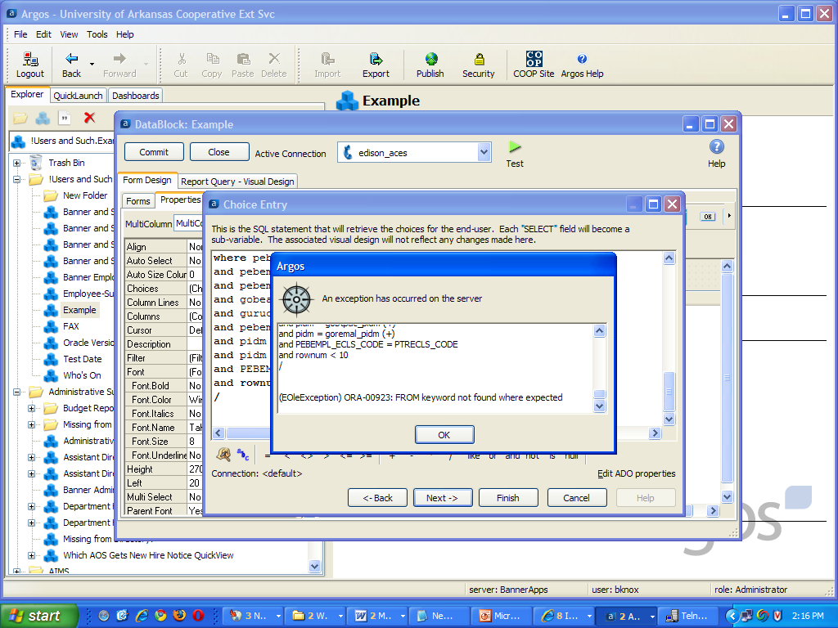
My favorite Argos QuickView
Notes:
OK, I did say leave the SQL*Plus extensions behind. Drop the /

Slide 41
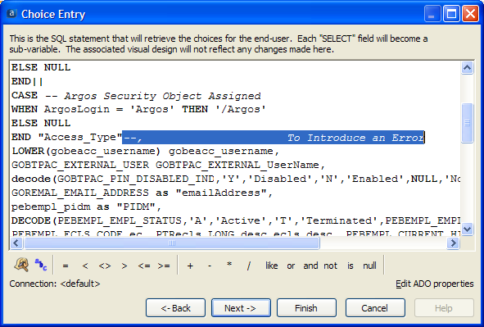
My favorite Argos QuickView
Notes:
Hmm, forgot the dummy’d error.

Slide 42
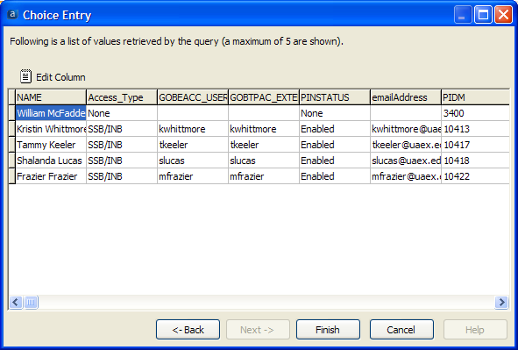
My favorite Argos QuickView
Notes:
The quick results from Next. This is actually quite useable, but you will want to pretty it up a bit for your users.

Slide 43
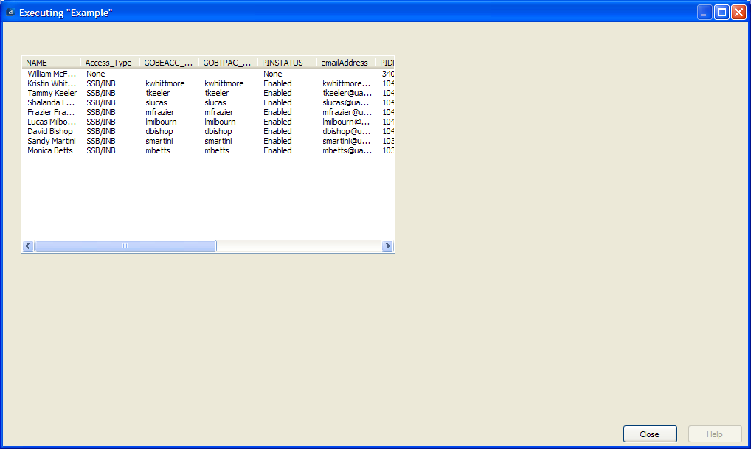
My favorite Argos QuickView
Notes:
Now remove the rownum < 10 statement.

Slide 44
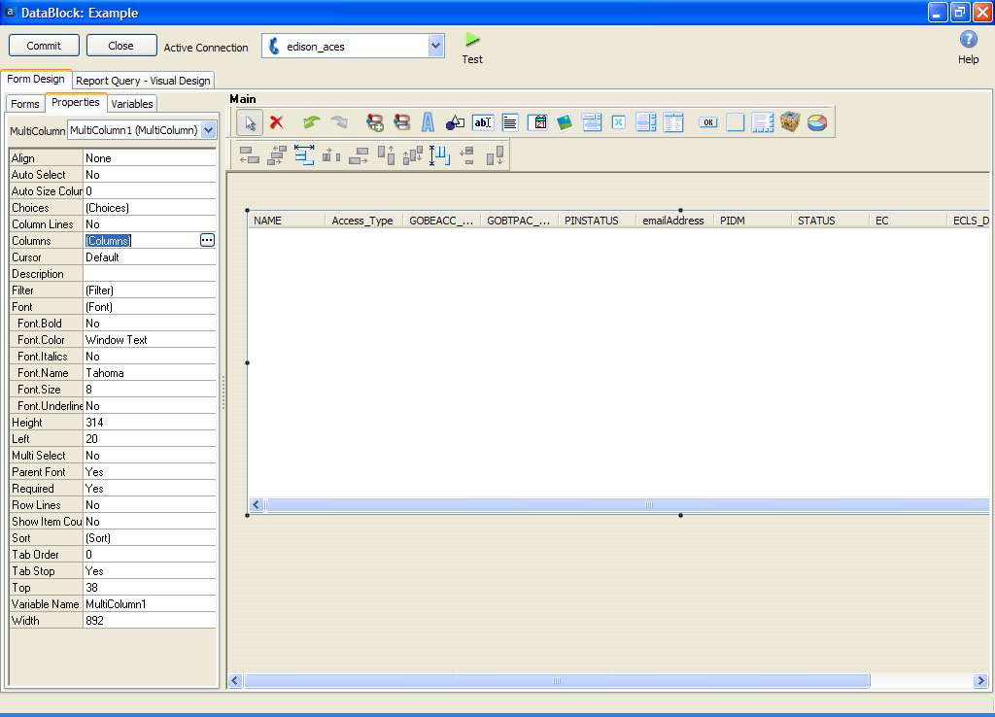
My favorite Argos QuickView
Notes:
You can stretch the box and pretty up the names if you like.

Slide 45
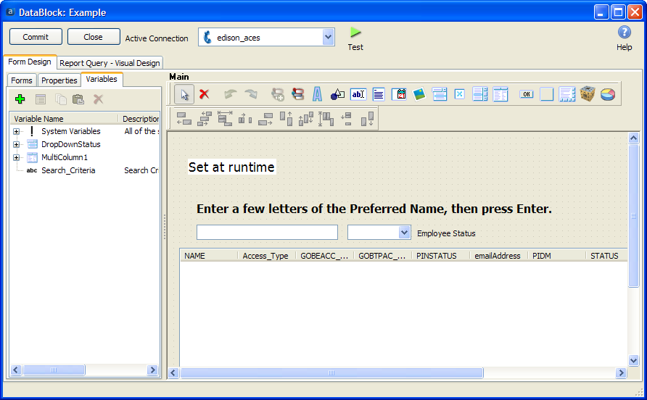
My favorite Argos QuickView
Notes:
I copied the logo and the dropdowns from another DataBlock. Less Icon hunting that way.

Slide 46
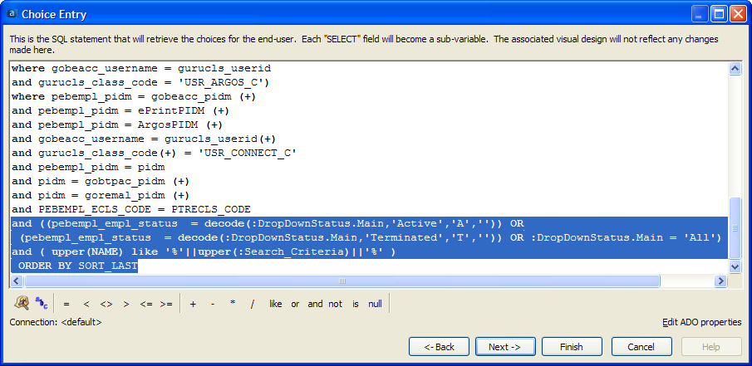
My favorite Argos QuickView
Notes:
This is the code that uses the dropdowns and also provides a bypass for All Employees.

Slide 47
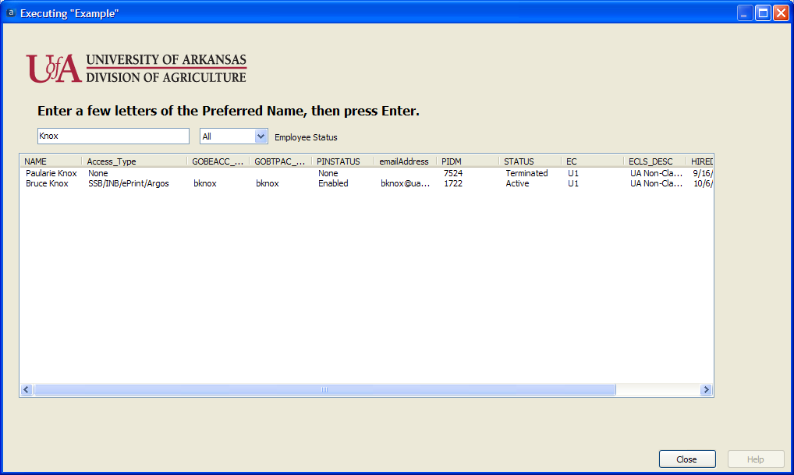
My favorite Argos QuickView
Notes:
Usually one wants only a known Active Employee. (Hint: Every employee have a space in their name.)

Slide 48
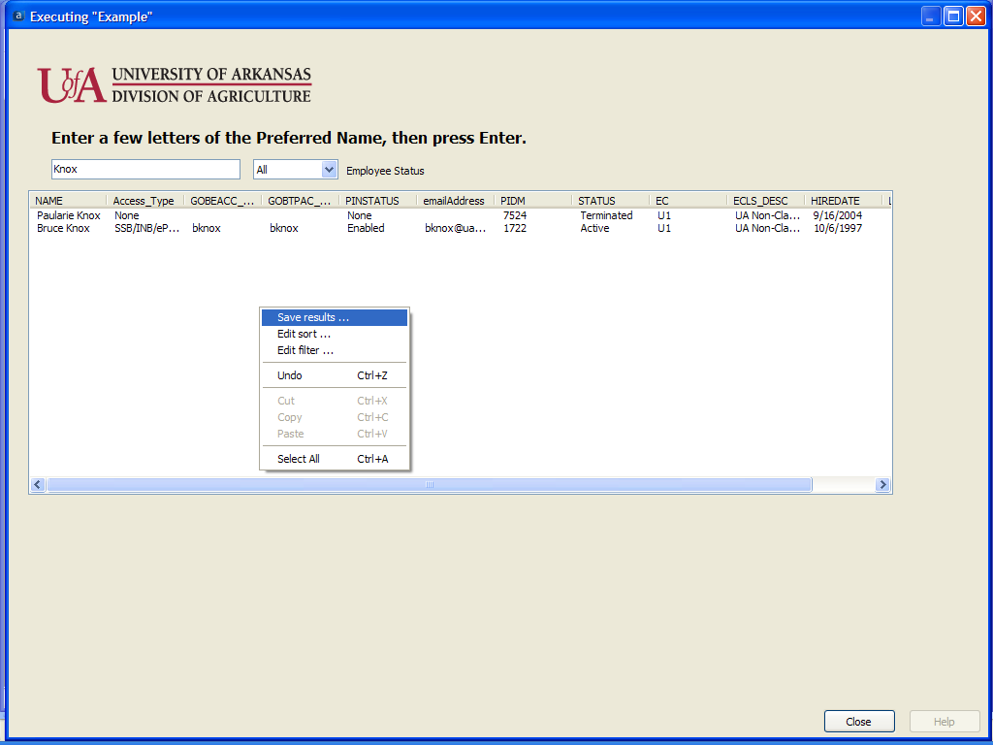
My favorite Argos QuickView
Notes:
Right-Click in the Displayed Results and Save results to a CSV file (if you ever need one).

Slide 49
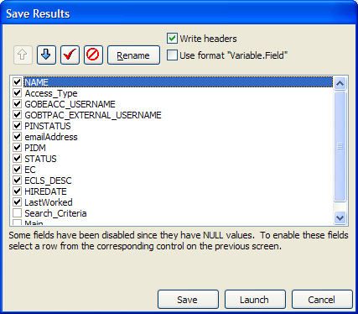
My favorite Argos QuickView
Notes:
Defaults to all columns.

Slide 50
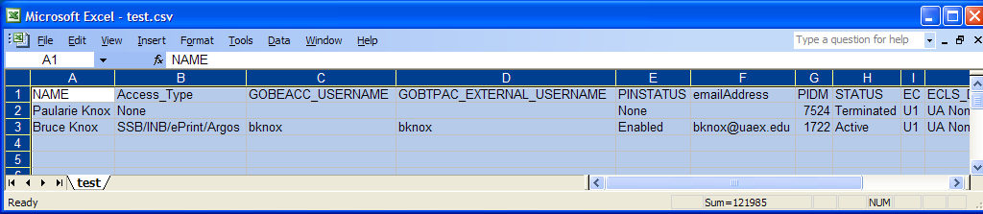
Tip: If you have Accounting users, give them CSV output.

Slide 51

Saturn V

Slide 52
Saturn V

Slide 53

Looking for the IU or Instrument Unit

Slide 54

Here it is all of three feet tall.

Slide 55

Saturn V

Slide 56


Slide 57
Please complete a session evaluation form
This session ID is 115
For further information please contact
Bruce Knox: bknox@uaex.edu http://betwinx.com/ or Evisions’ Professional Services at proservices@evisions.com

