Slide 1
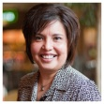







Argos - a Banner Reporting Community
Presented by: Bruce Knox
University of Arkansas,
Division of Agriculture,
Cooperative Extension Service
March 23, 2011
Session ID 4575
Notes:
Prelude

Slide 2
Bruce Knox
Over 12 years of Banner Reporting
bknox@uaex.edu
http://betwinx.com/ Banner Reporting
http://betwinx.com/BannerArgos.htm BannerArgos
Notes:
I have used a wide variety of reporting tools with Banner.

Slide 3
Arkansas is Our Campus
The Cooperative Extension Service is part of the University of Arkansas' Division of Agriculture.
With offices in all 75 counties, our faculty and staff provide educational programs and research-based information to the people of Arkansas.
Notes:
From agricultural programs to family financial management to youth education, we offer educational programs that have immediate and practical applications.
You might know us from 4-H or Master Gardeners.
Our focus is upon educational programs that have immediate and practical applications.

Slide 4
Introduction
Our purpose here is to discuss the Evisions Argos user Community and Extended Argos Resources
You should take away a general introduction to the Argos Community and some specific extensions beyond the Evisions provided user Portal
How to locate sources of free software and useful information
Notes:
Introduction

Slide 5
Agenda
Argos
Built-In Community
The Argos COOP
Sharing is Encouraged
Training
Support
An Example of a Community Developed Solution
Other Resources

Slide 6
Argos

Slide 7
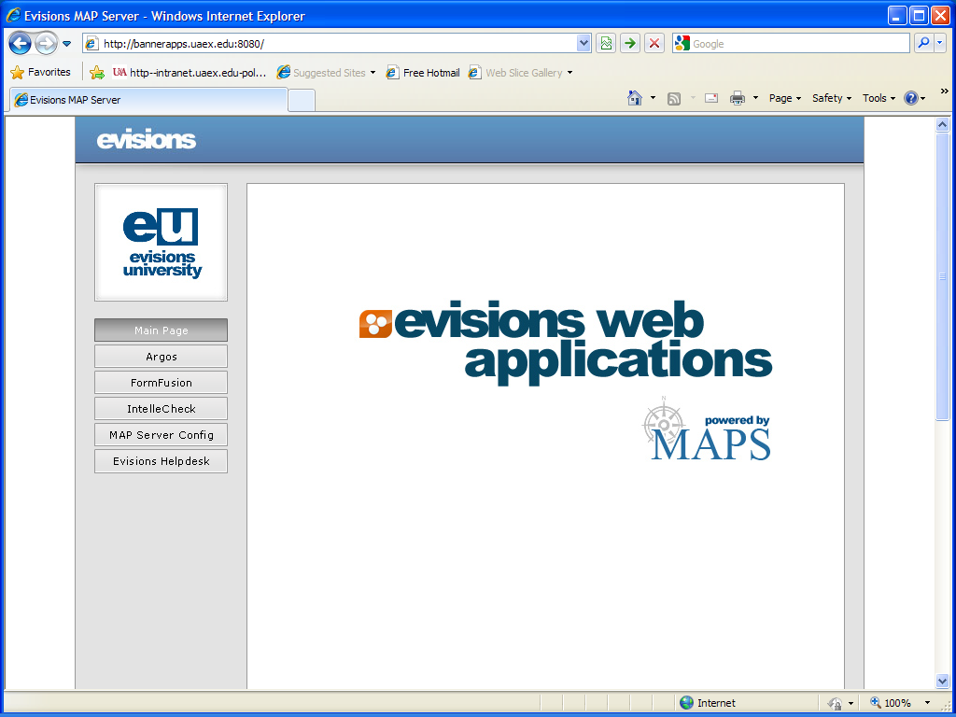
Notes:
Argos is a Web Based Reporting Tool.

Slide 8
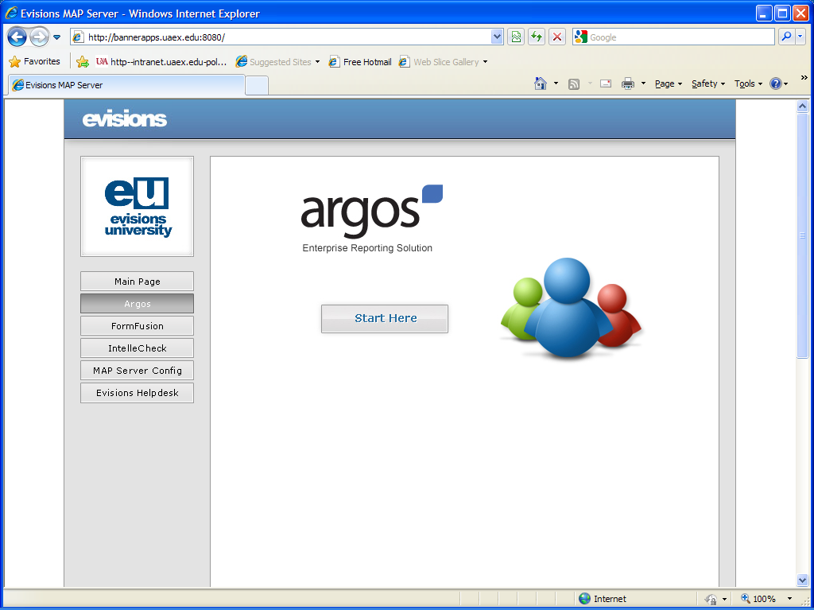
Notes:
Argos uses the Evisions Multiple Application Platform Server to communicate with Banner or other Databases.

Slide 9
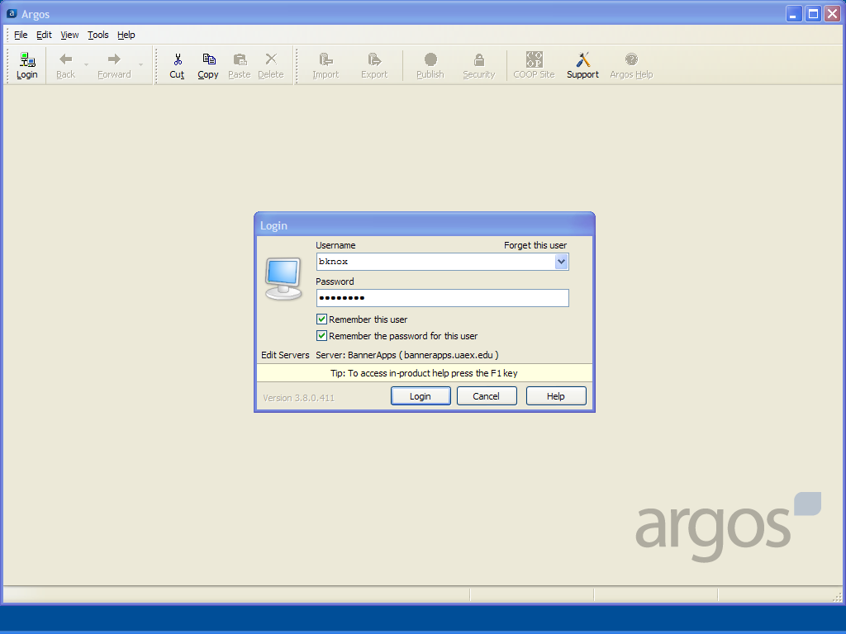
Notes:
Most of our users are authenticated via LDPA (Active Directory).

Slide 10
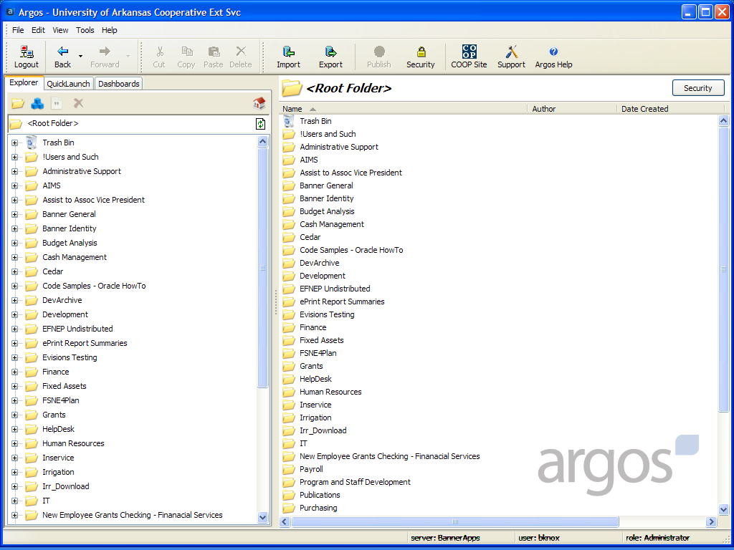
Notes:
My Administrator Argos Root Folder is far busier than is typical for our Functional Users.

Slide 11
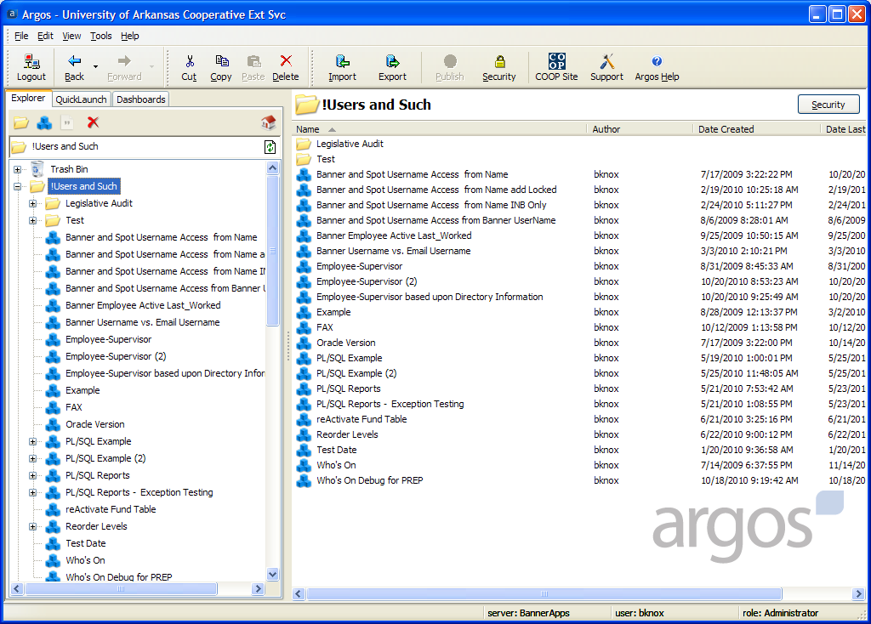
Notes:
My Collection is not seen by any other user.

Slide 12
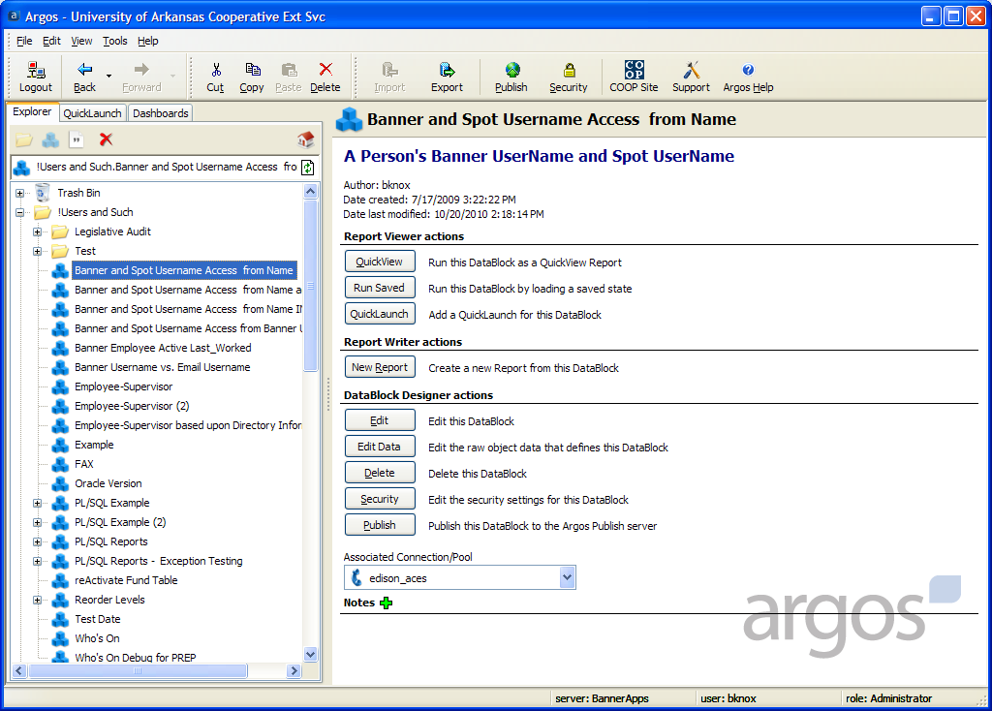
Notes:
The QuickView I use most often is one to help manage Banner and Luminis passwords and security.

Slide 13
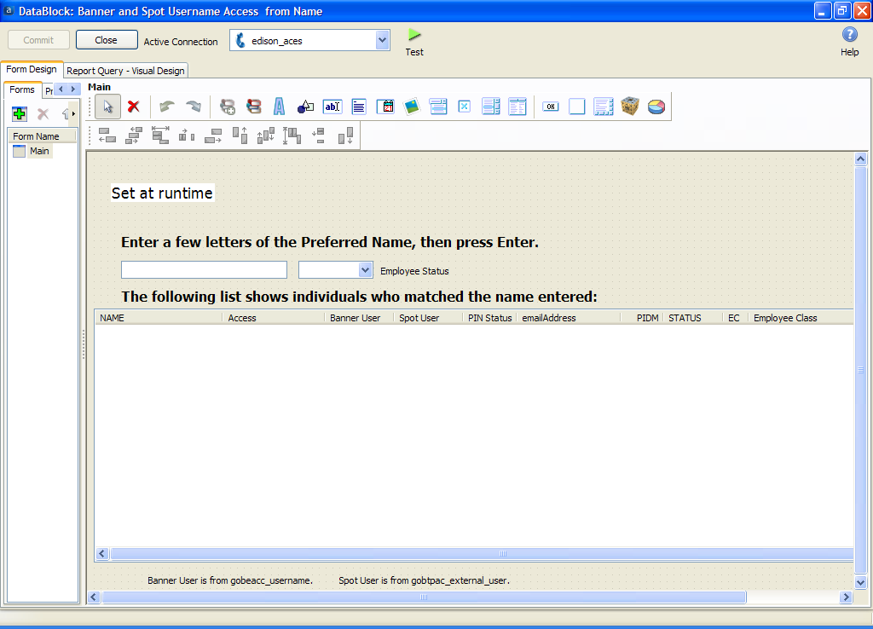
Notes:
Spot is our Luminis Portal’s name.

Slide 14
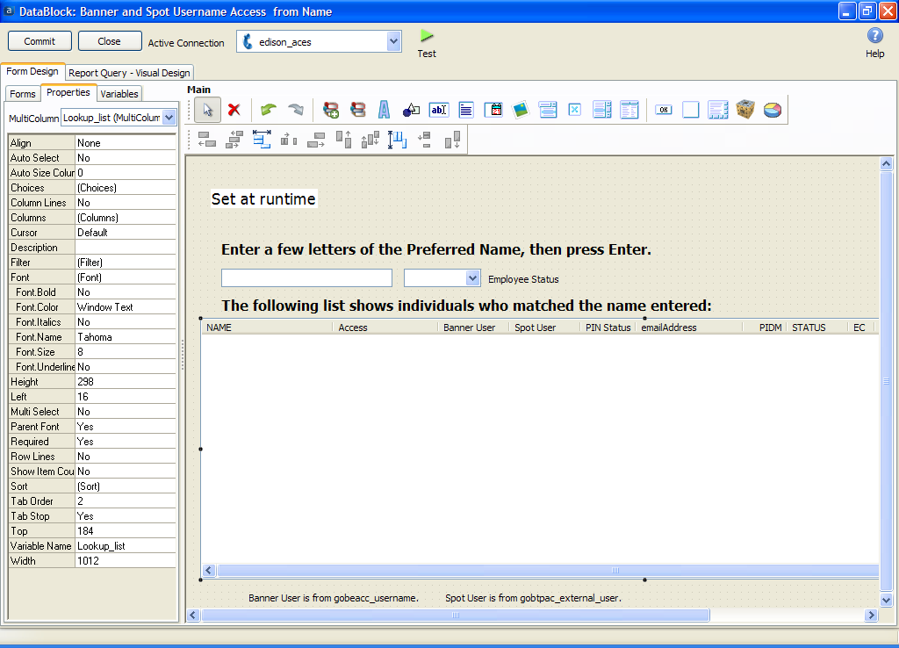
Notes:
This interface is very familiar to anyone that know an object oriented design tool.

Slide 15
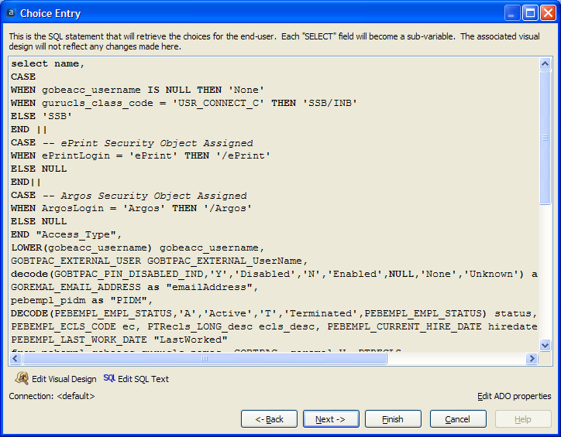
Notes:
I particularly like the ability to use SQL code without the Visual Design tools.

Slide 16
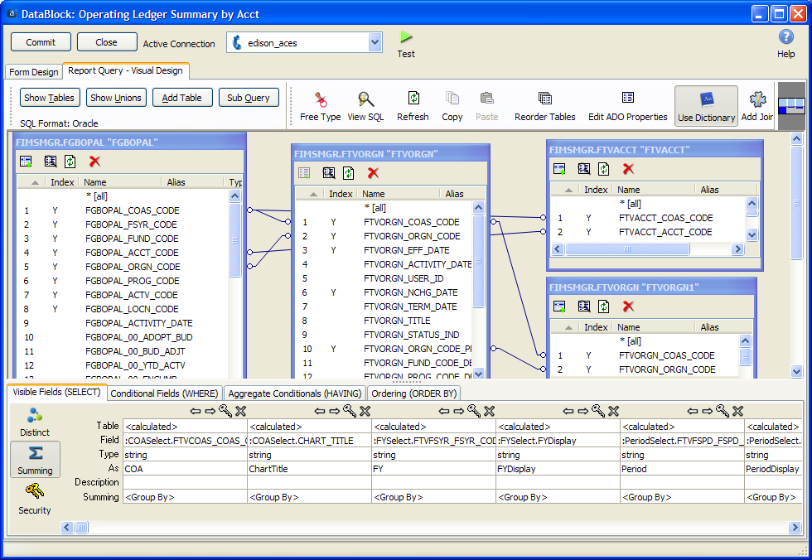
Notes:
If you prefer Visual Design, Argos will look very familiar to you.

Slide 17
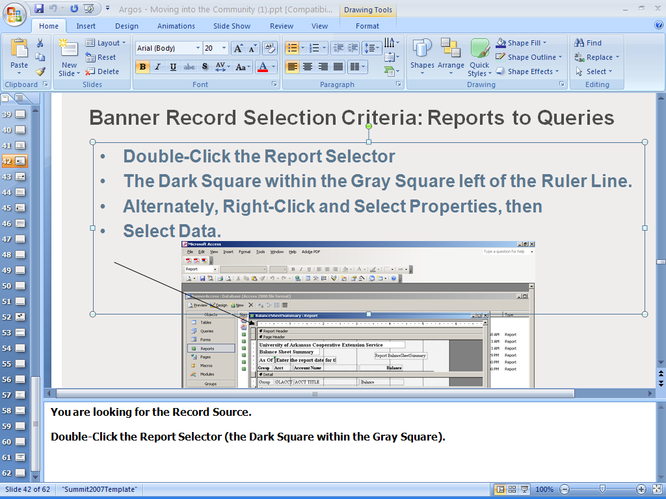
Notes:
Converting MS Access is a snap once you know the key to locating a Report’s underlying Query.

Slide 18
Argos Community
Notes:
The Argos Community is rather active.

Slide 19
Argos Community
Community really is Built into Argos
Notes:
The Argos Community is actually Built-in to the User Interface.

Slide 20
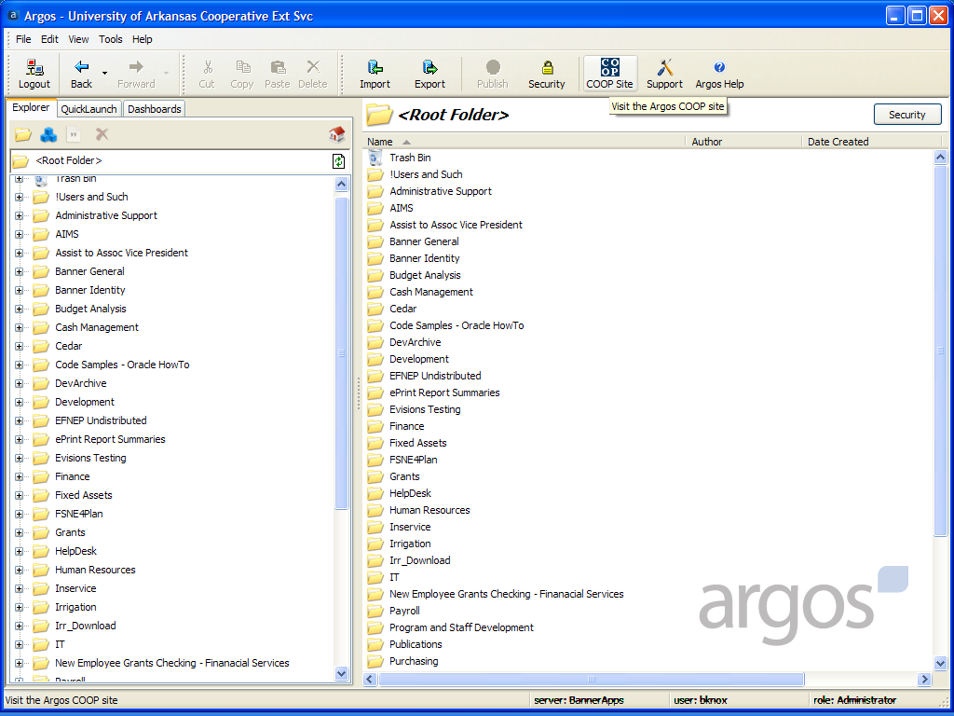
Notes:
You can go directly to the User Community from the GUI.

Slide 21
Argos COOP Site
Upload
Search
Download
Notes:
This is the first Portal I have used that prompts one to Upload first.

Slide 22
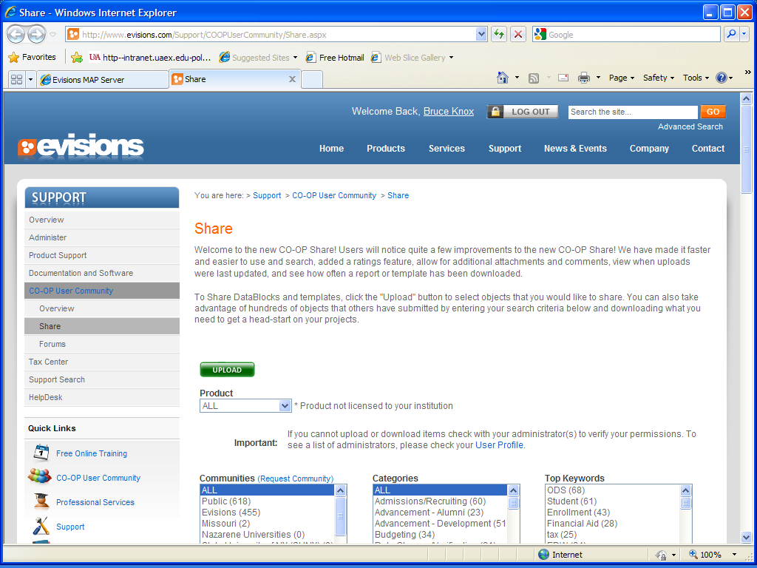
Notes:
Share/Upload at the start.

Slide 23
Argos Community
Sharing is Encouraged
Notes:
Sharing is actually encouraged.

Slide 24
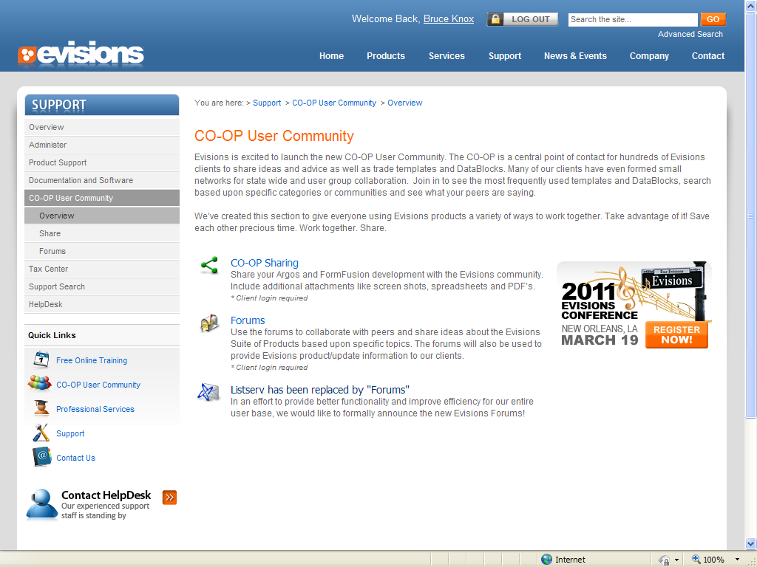
Notes:
Many ways to enter and solve a problem.

Slide 25
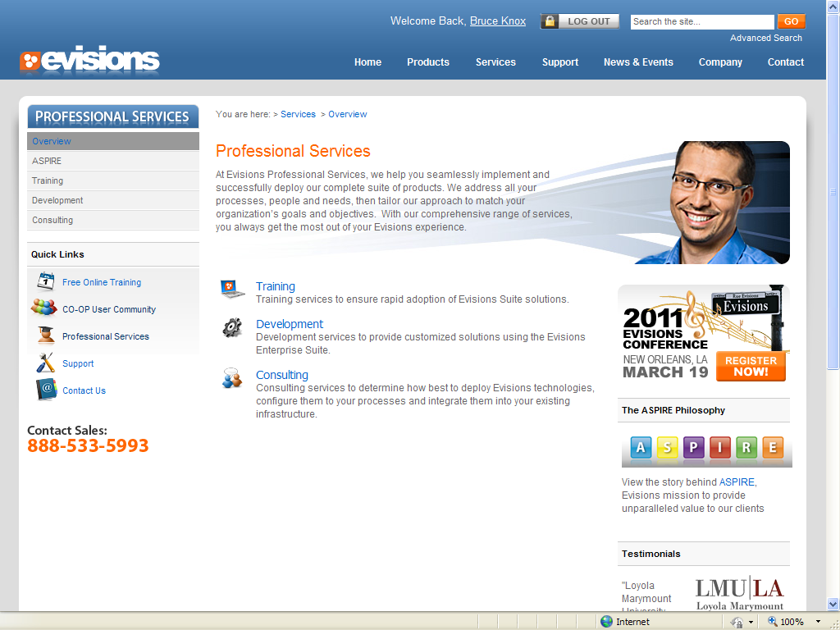
Notes:
No, I am not selling. We are going to the free training.

Slide 26
Argos Training
Notes:
Training

Slide 27
Argos Training
Onsite
Notes:
Onsite Training

Slide 28
Argos Training
Onsite
Online Live
Notes:
Online Live

Slide 29
Argos Training
Onsite
Online Live
Online Recorded
Notes:
Online Recorded suites my schedule better.

Slide 30
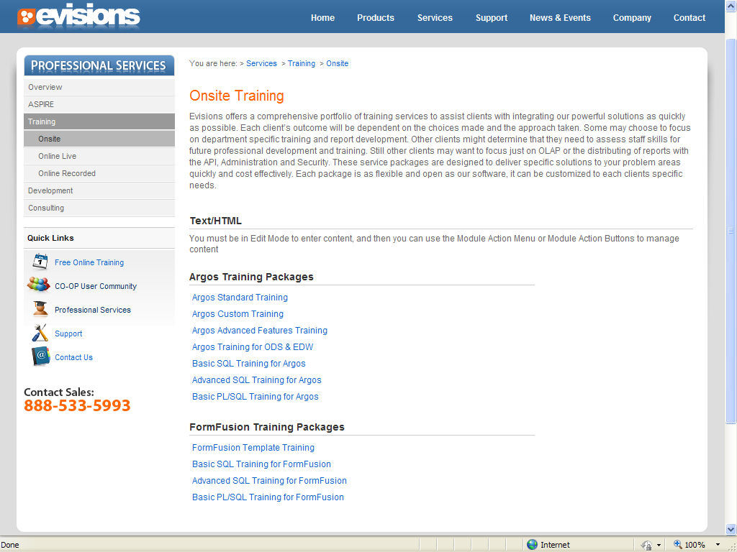
Notes:
Onsite

Slide 31
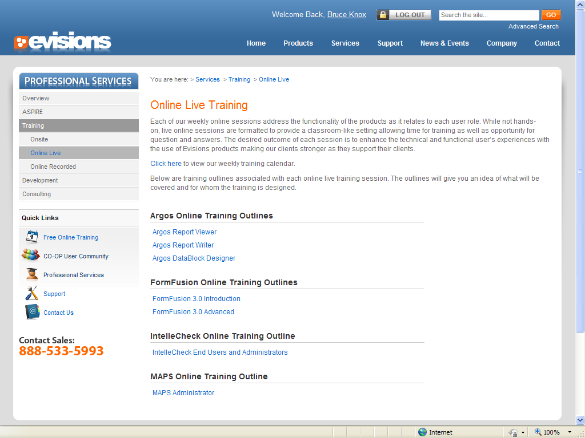
Notes:
Online Live

Slide 32
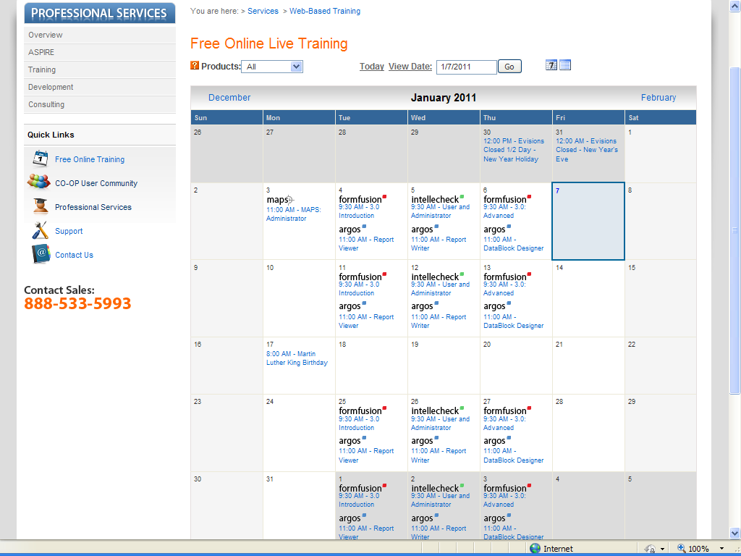
Notes:
A typical calendar of scheduled free online live training.

Slide 33
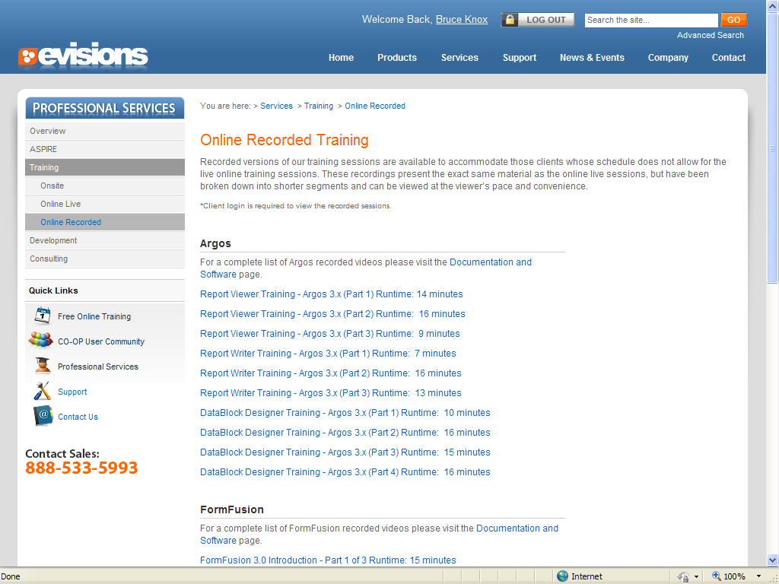
Notes:
Recorded training is my preference because I am interrupted frequently.

Slide 34
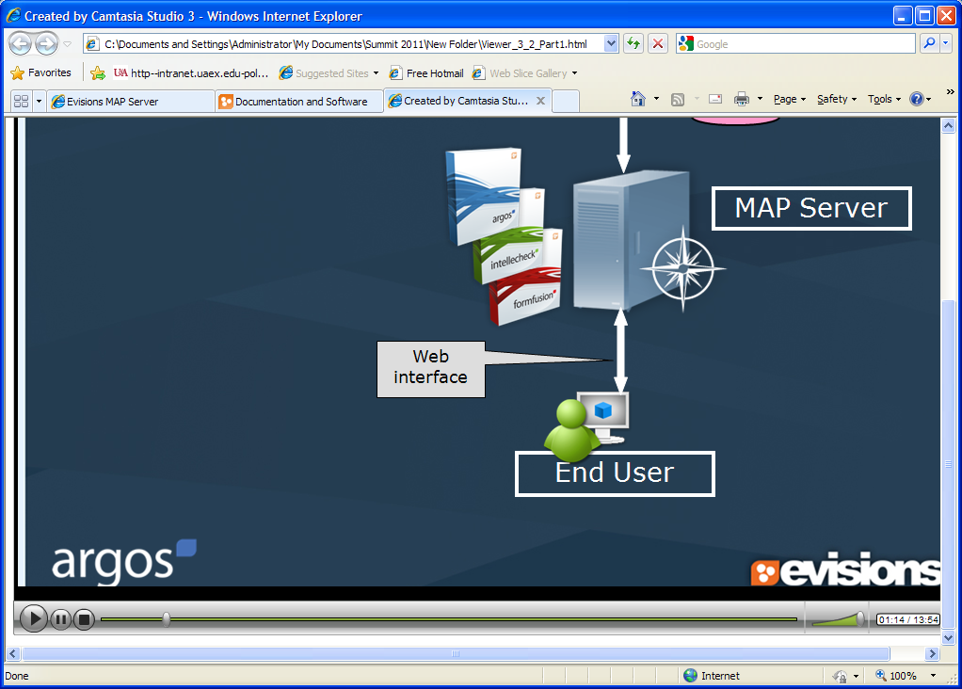
Notes:
This is just a snapshot and is fairly typical. I really need the pause button.

Slide 35
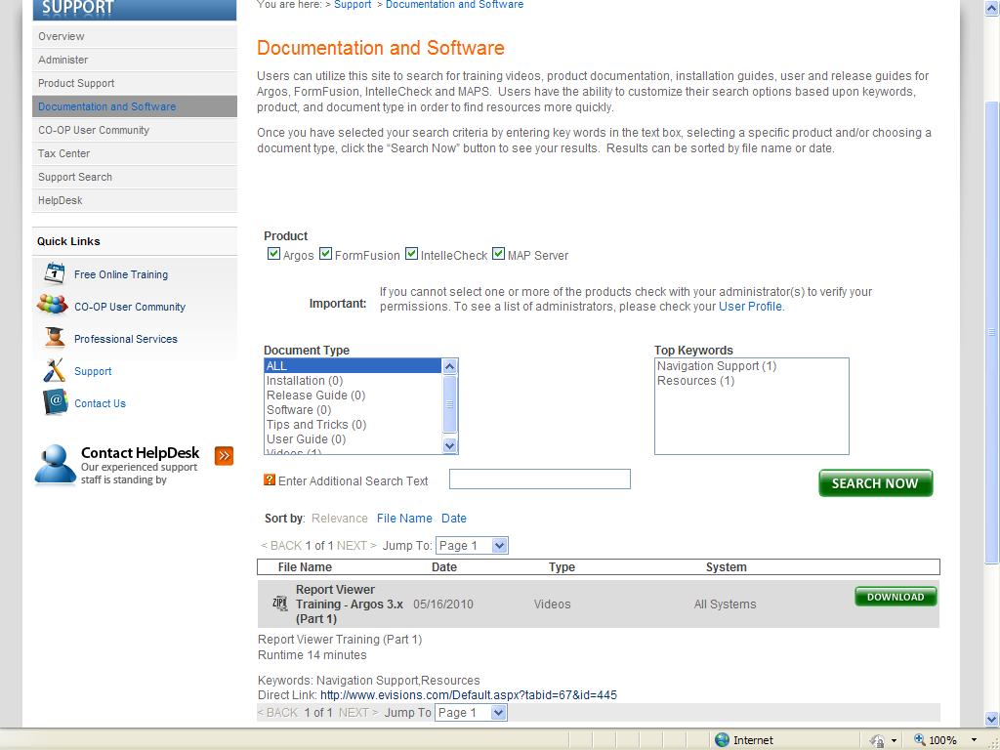
Notes:
Traditional documentation is available as PDF documents.

Slide 36
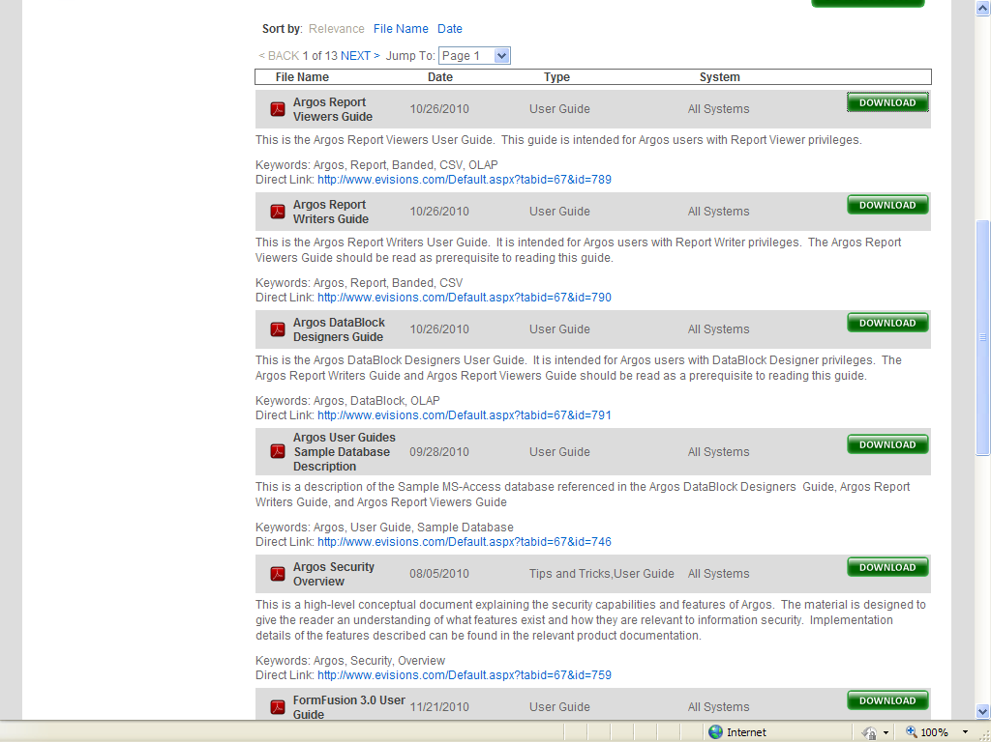
Notes:
The download and save process is typical, but nothing so onerous as the Oracle site.

Slide 37
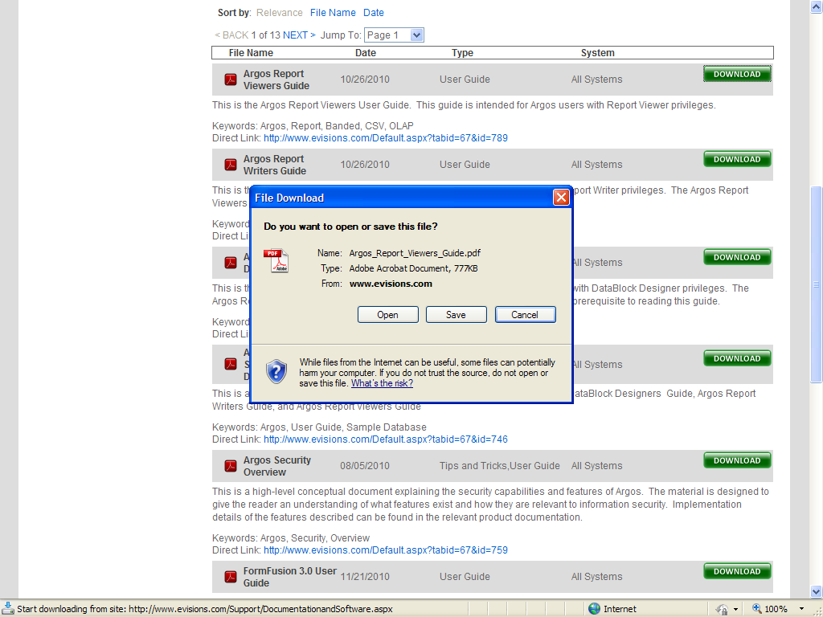
Notes:
With your single login, you are into the entire site.

Slide 38
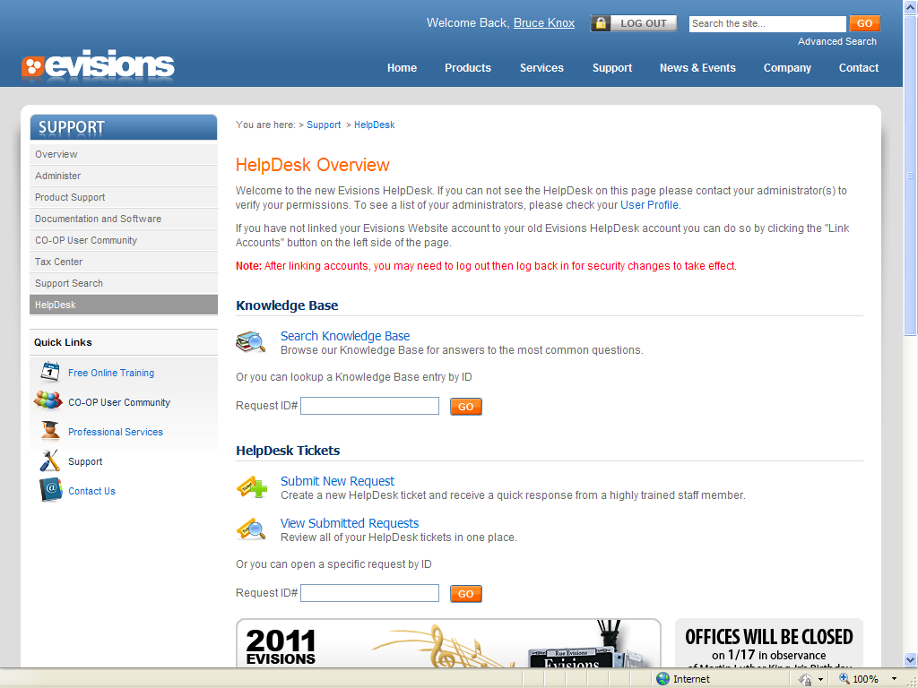
Notes:
But, sometimes you do need the Help Desk.

Slide 39
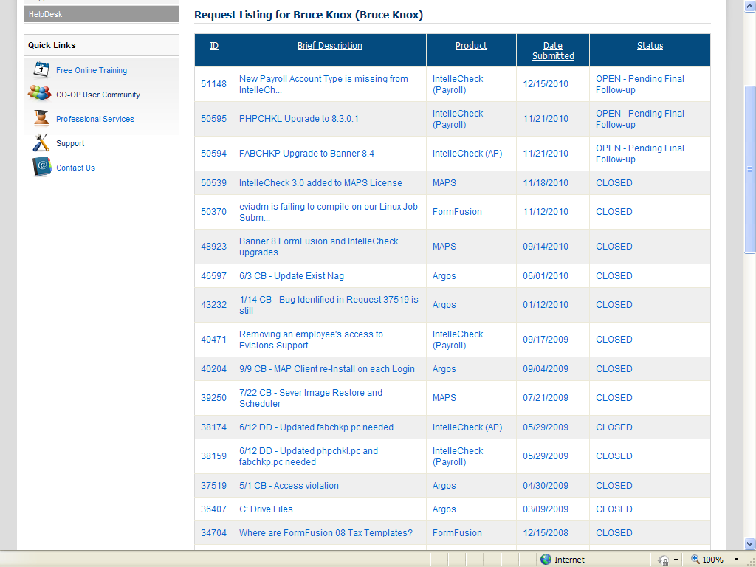
Notes:
I am a frequent visitor because I am supporting a lot of new (to me) products.

Slide 40

Notes:
Many ways to get to anywhere you need to be.

Slide 41
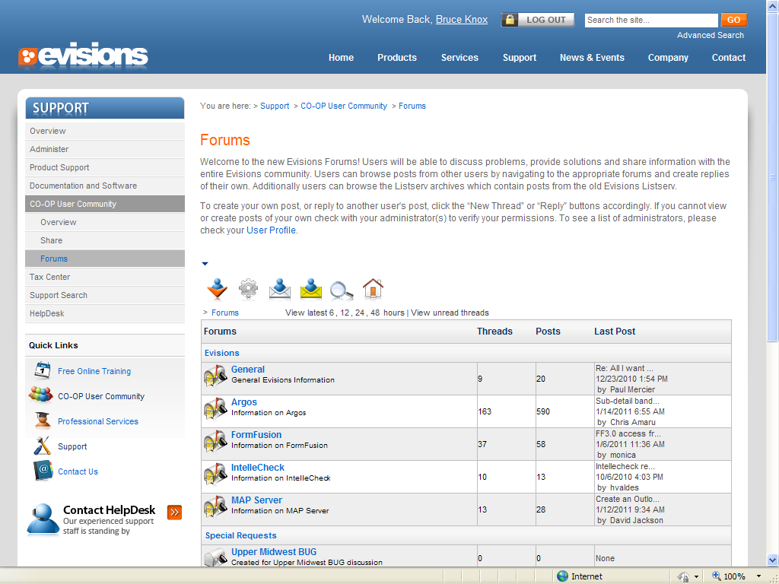
Notes:
The Forums have replaced the Listserv. The Argos Forum is very active.

Slide 42
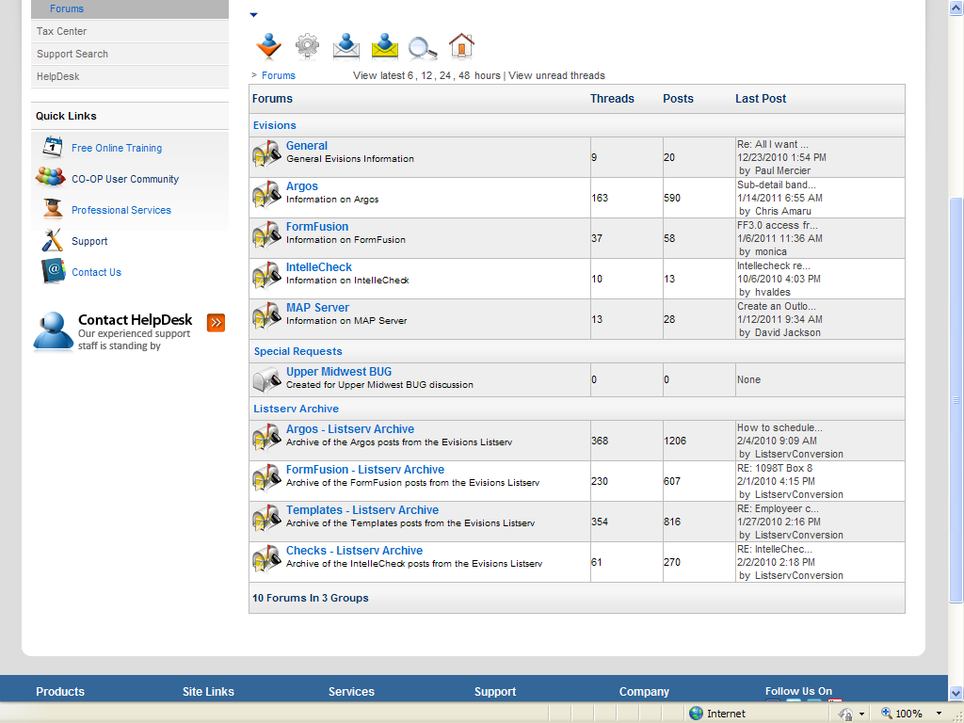

Slide 43
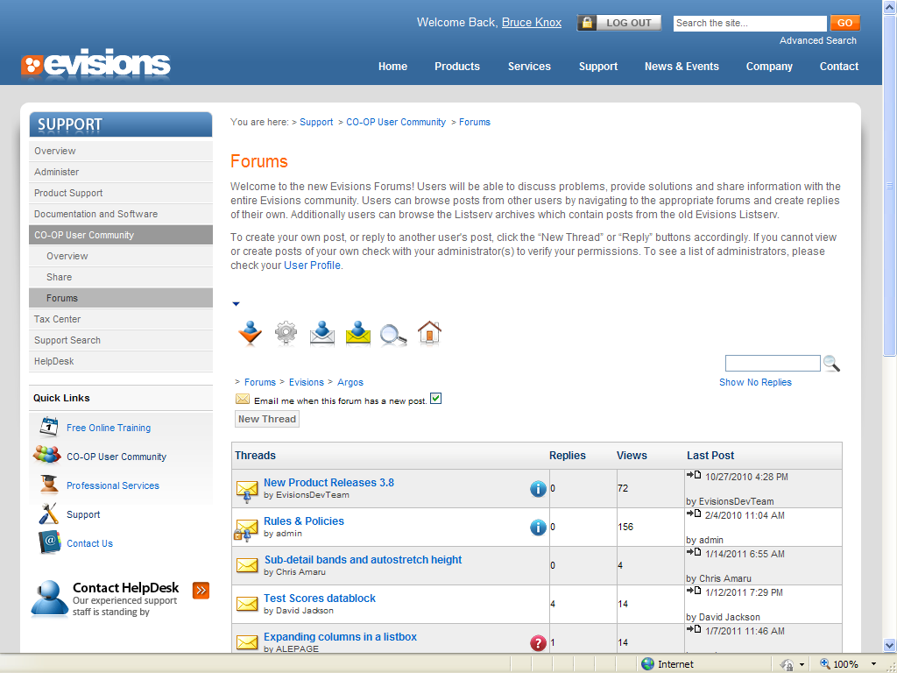
Notes:
I personally prefer to keep up to date via email and all it took was a check mark as above.

Slide 44
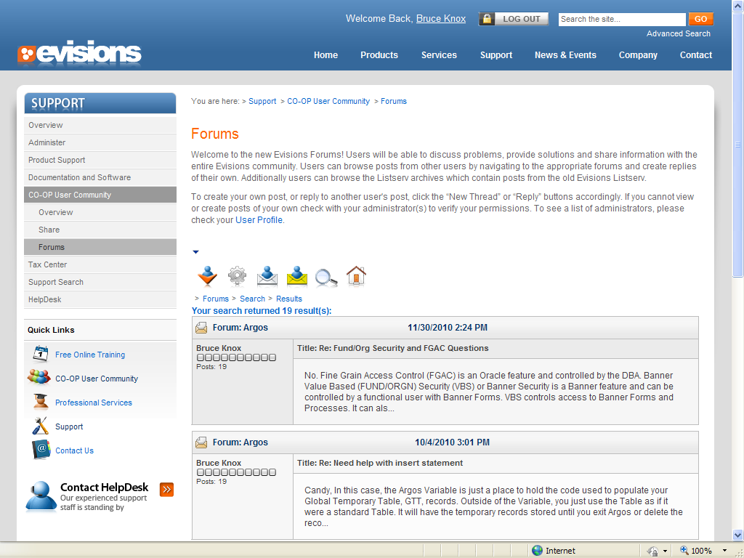
Notes:
I am not as frequent a contributor with the Forum as I was with the Listserv. But, some contribute much more using the Forum than they did with the Listserv.

Slide 45
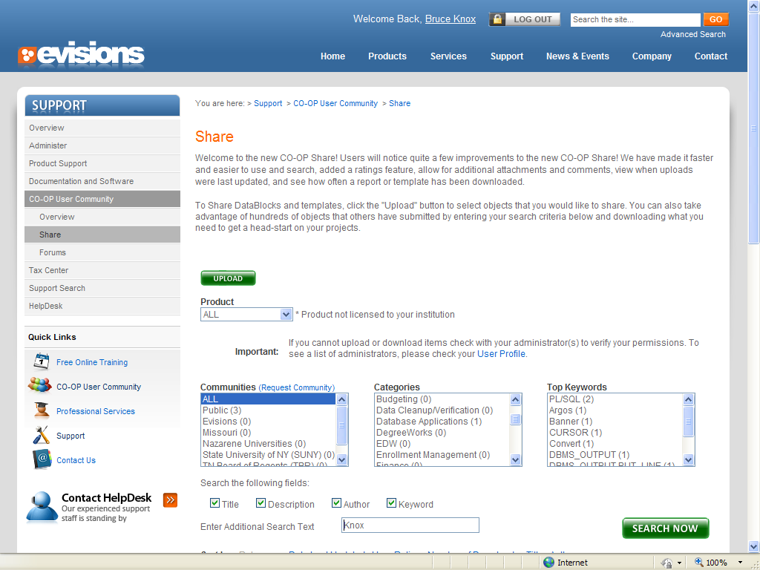
Notes:
Now an example of shared objects.

Slide 46
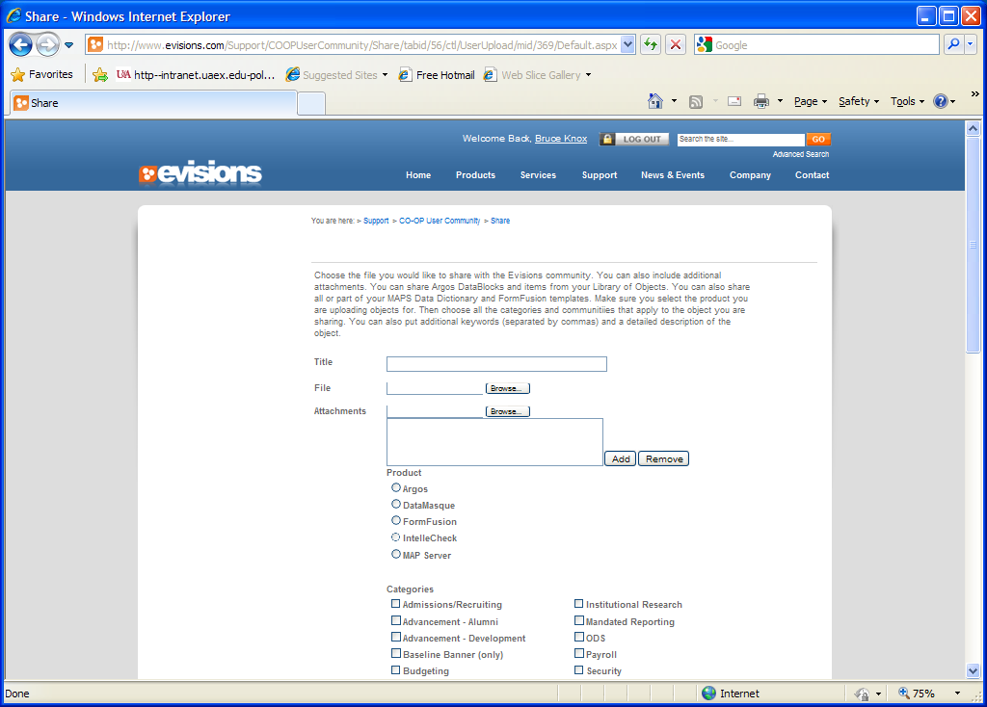
Notes:
Upload is almost as easy as this download. Just a few questions to sort the object correctly.

Slide 47
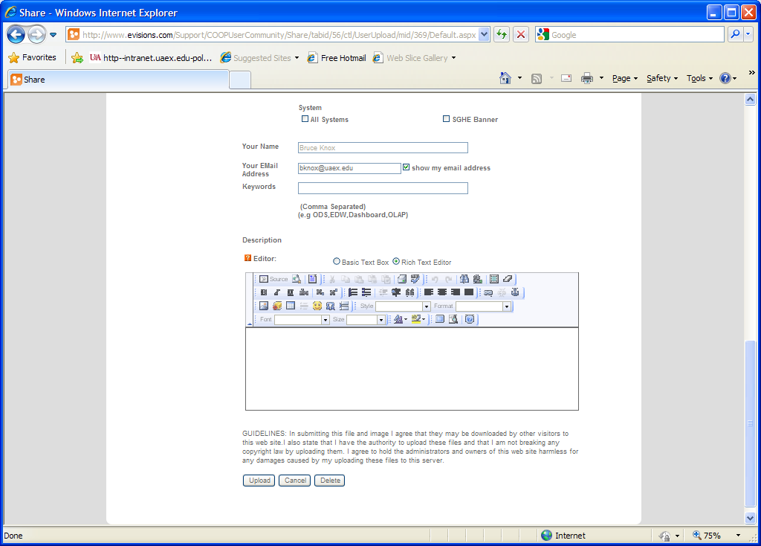
Notes:
Note the very limited submission rules.

Slide 48
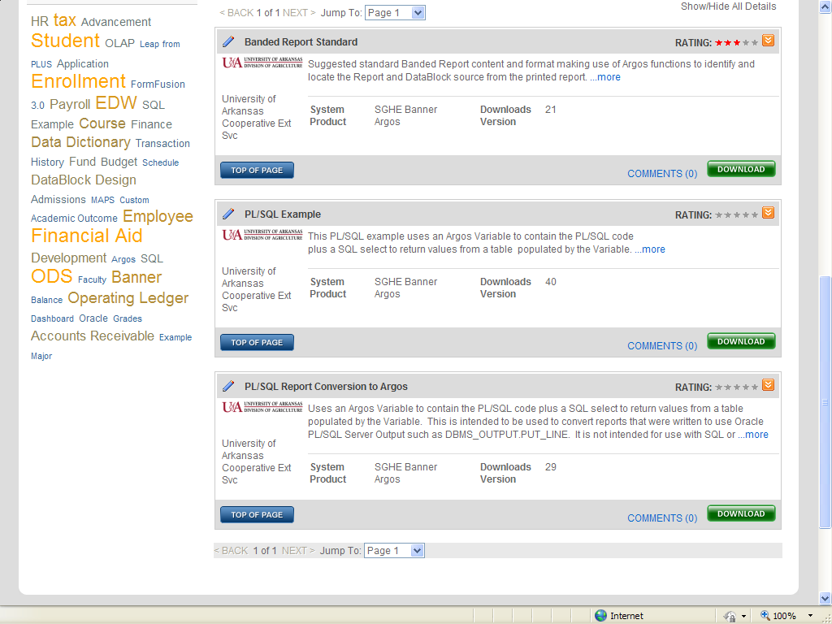
Notes:
Evisions identifies the source of a contribution.

Slide 49
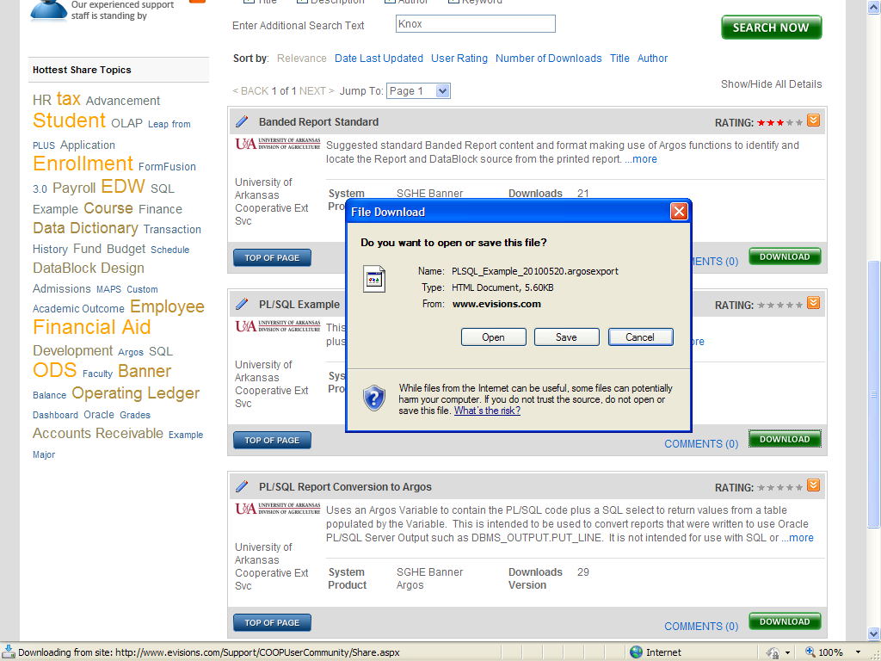
Notes:
Now reversing the process.

Slide 50
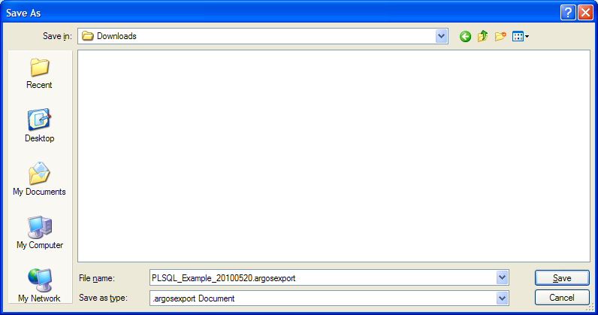
Notes:
Note the .argosexport extension

Slide 51
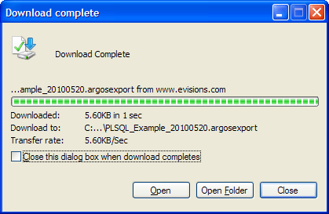
Notes:
Quick

Slide 52
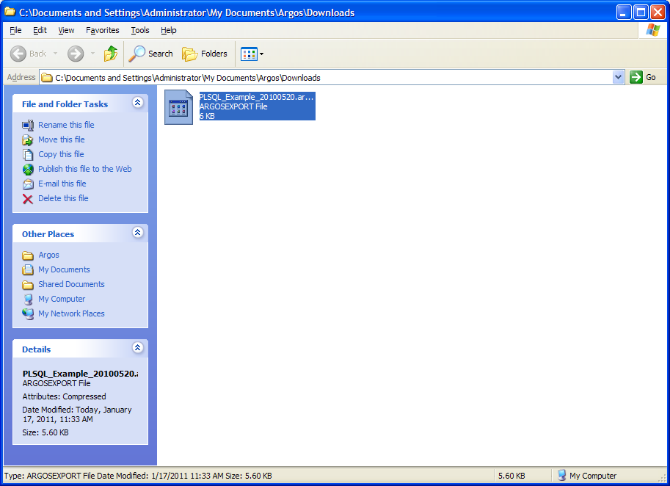

Slide 53
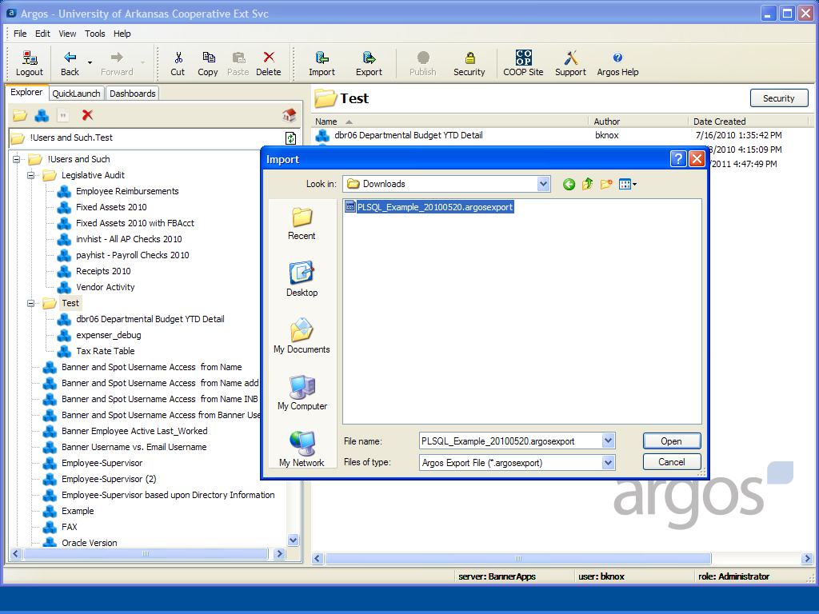
Notes:
A place to save the new object into Argos.

Slide 54
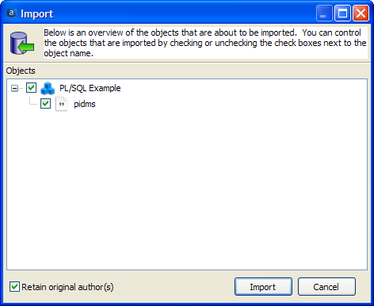
Notes:
Import by locating into the Argos Destination Folder.

Slide 55
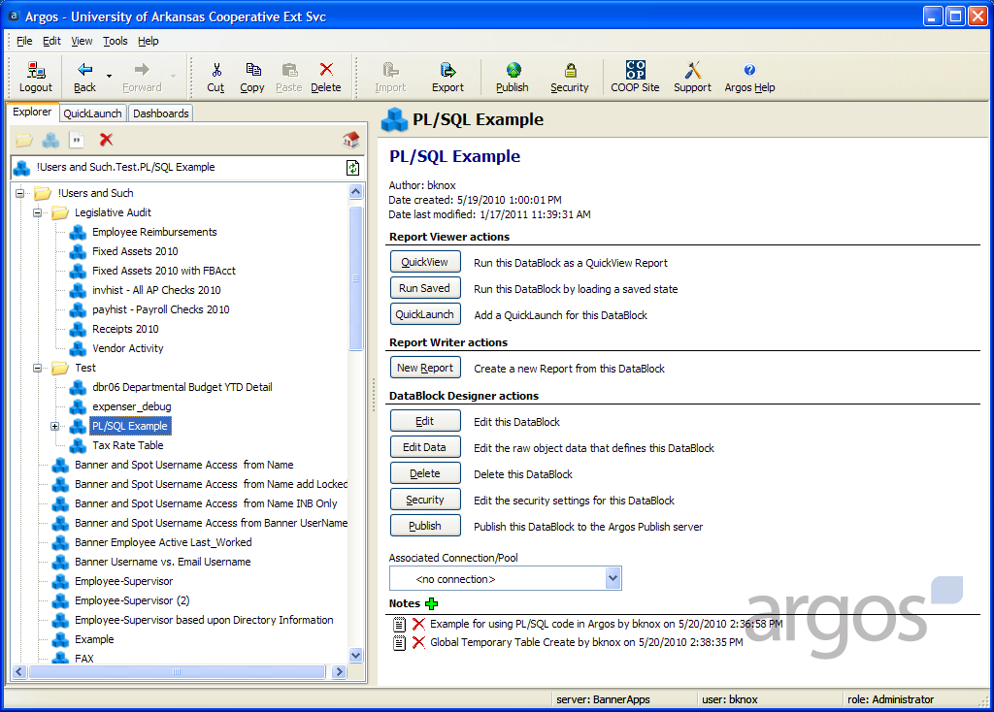
Notes:
Keep the name or change it. The Notes and Reports will import with the DataBlock.

Slide 56
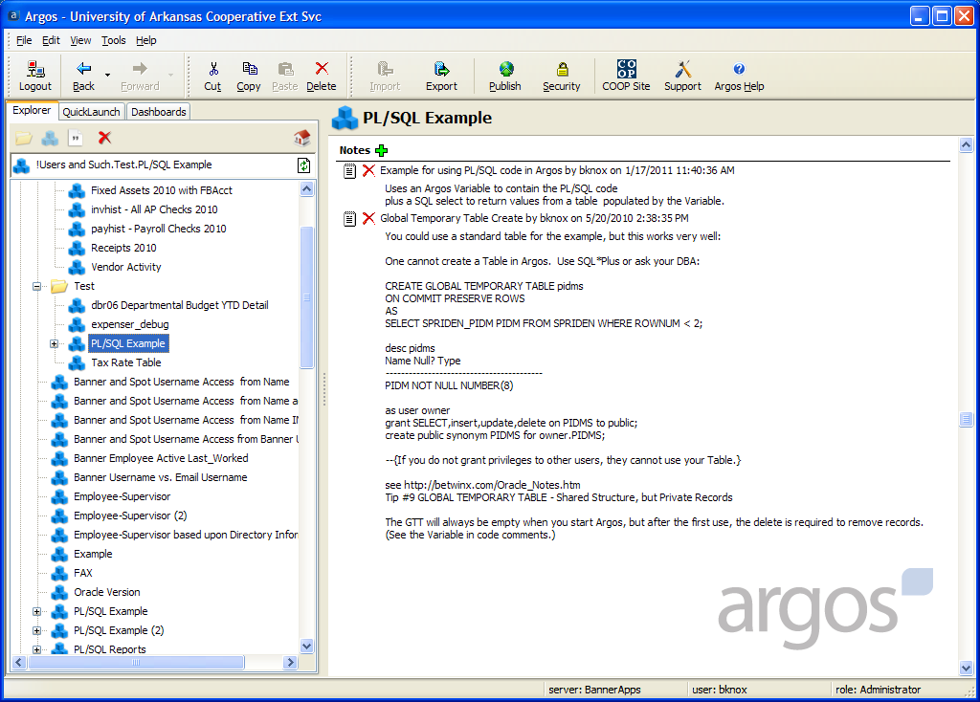
Notes:
Notes is the likely place to contain explanations or any code needed outside of Argos.

Slide 57
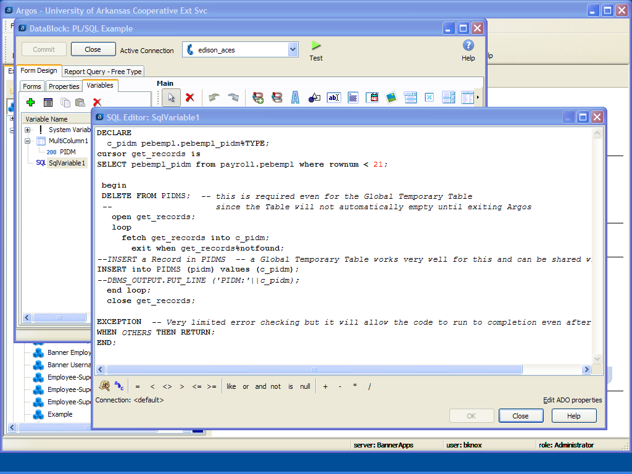
Notes:
And it is complete once imported. The Folder’s default security will be used for the new objects.

Slide 58
Extended Resources
Calvin Deiterich’s Argos Reporting
http://www.argosreporting.net/
Zach Heath’s Banner Reporting Blog
http://bannerreporting.blogspot.com/
Banner Reporting Solutions
http://betwinx.com/
BannerScripts
http://betwinx.com/BannerScripts.htm
Notes:
There are several non-Evisions websites with extended Argos help and information.

Slide 59
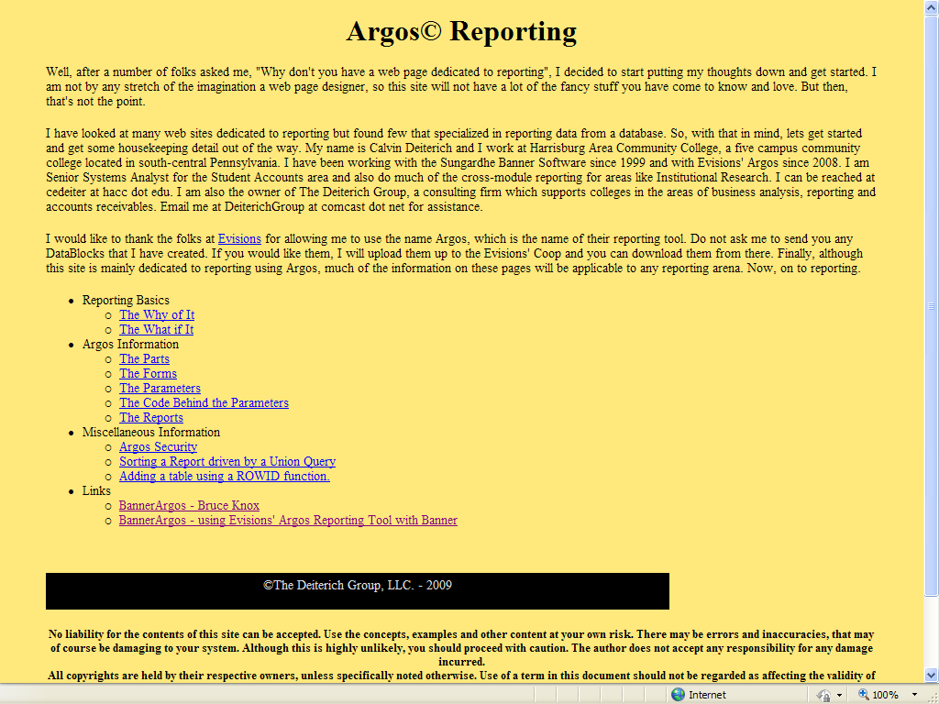
Notes:
Calvin is a long time Argos user and contributor.

Slide 60
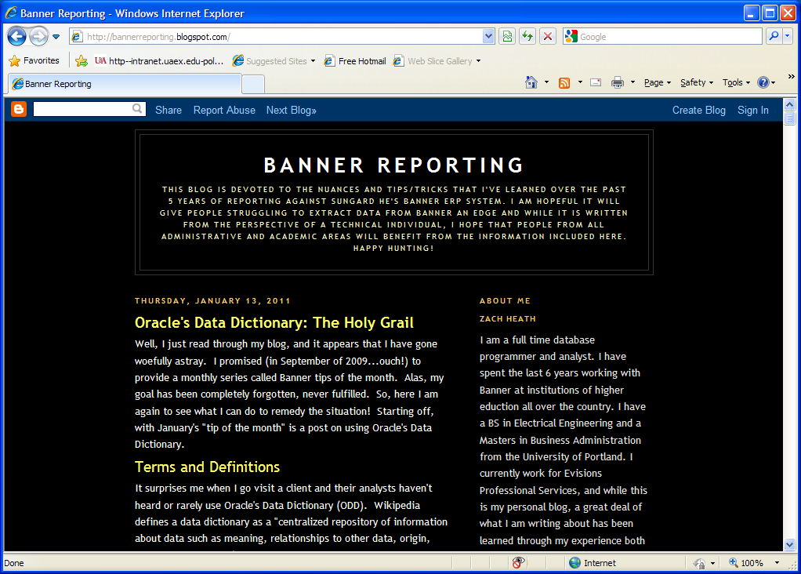
Notes:
Zach is a good source of technical information useful to Argos users.

Slide 61
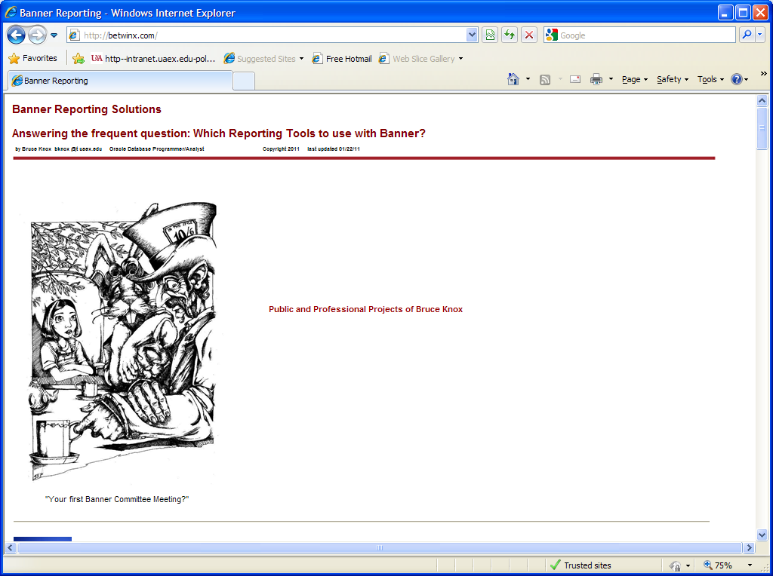
Notes:
My Banner Reporting site is not just for Argos.

Slide 62
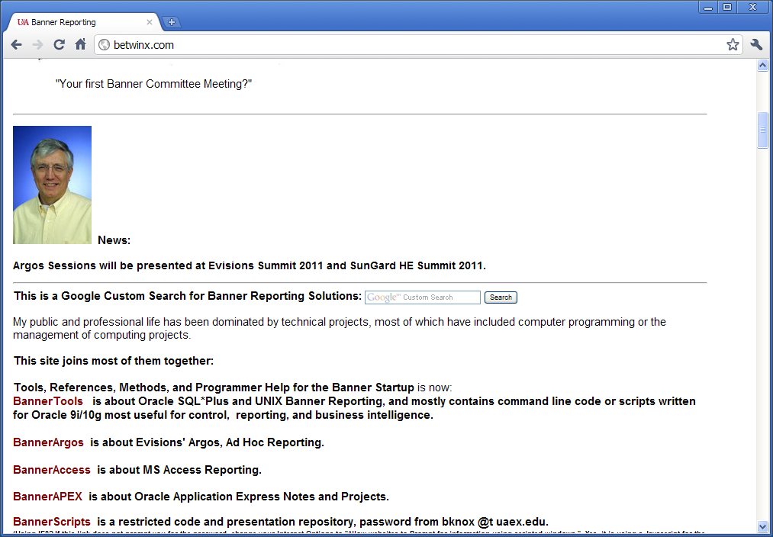
Notes:
BannerArgos is replacing my old BannerAccess and much more.

Slide 63
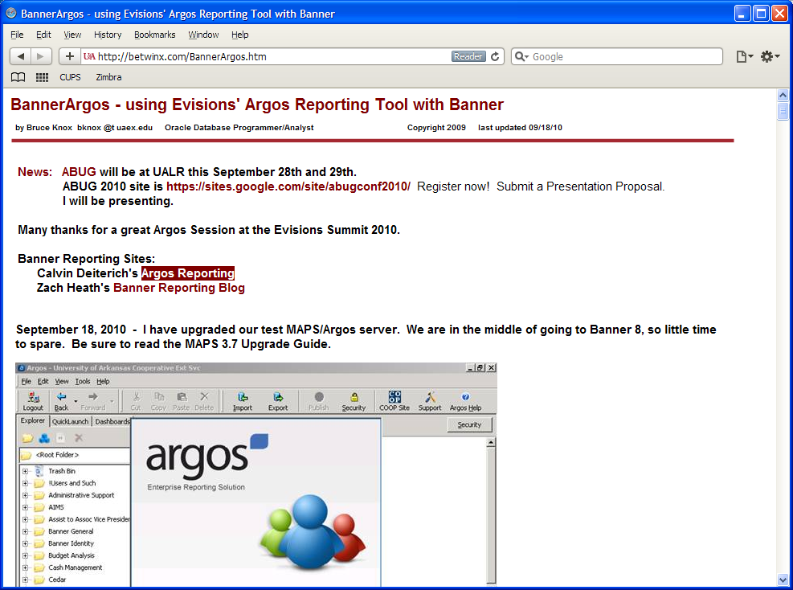
Notes:
Keeping up has become difficult since the economy has restricted hiring.

Slide 64
Banner Scripts Repository
BannerScripts http://betwinx.com/BannerScripts.htm
The password is a lower case
scripts
Notes:
I have several presentations of a more technical nature that are store in my Banner Scripts Repository. It does require a password.

Slide 65
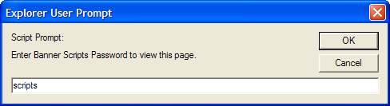
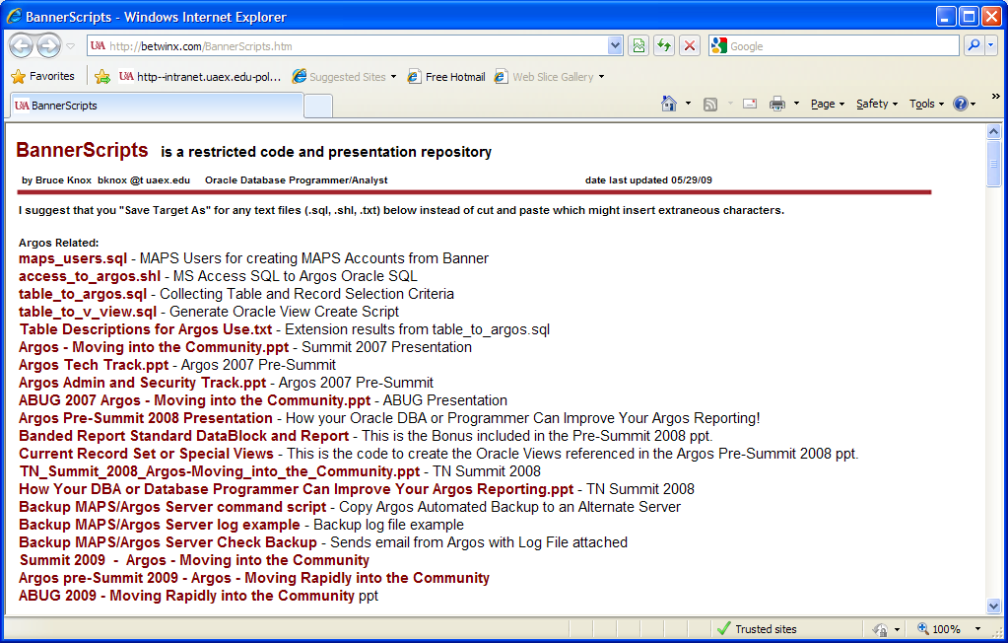
Notes:
Once into the Repository, see the Argos Related section.

Slide 66

New Site’s Use

Slide 67
Summary
The Argos Community is Built into the Product
Sharing is Encourage
Training is both Available and Flexible
Extended Resources are Available

Slide 68
Questions & Answers
Bruce Knox
bknox@uaex.edu
http://betwinx.com/

Slide 69
Thank You!
Bruce Knox
bknox@uaex.edu
http://betwinx.com/
Please complete the online Session evaluation form
Session ID 4575
SunGard or its subsidiaries in the U.S. and other countries is the owner of numerous marks, including “SunGard,” the SunGard logo, “Banner,” “PowerCAMPUS,” “Advance,” “Luminis,” "DegreeWorks," "fsaATLAS," “Course Signals,” and “Open Digital Campus.” Other names and marks used in this material are owned by third parties.
© 2011 SunGard. All rights reserved.

